Slide 1
Active documents and Active XML
Serge Abiteboul
INRIA Saclay, Collège de France, ENS Cachan
4/3/12
1

Slide 2
Organization
Introduction
Modeling data intensive distributed systems
Query optimization in distributed systems
Monitoring in distributed systems
Task sequencing in distributed systems
Conclusion

Slide 3
Introduction

Slide 4
Context: Web data management
Scale: lots of servers, large volume of data
Servers are autonomous (heterogeneous also)
Data may be very dynamic, heavy update rates
Peers are possibly moving
The focus in this class
Relation | → | Tree
Centralized | → | Distributed
Precise data | → | Incomplete, probabilistic
Precise schemas | → | Ontologies

Slide 5
The lesson from the past
The success of the relational model with 2D-tables on local servers
A logic for defining tables
An algebra for describing query plans over tables
We should do similarly for trees in a distributed environment
A logic for defining distributed trees and data services
An algebra for optimizing queries over trees/services

Slide 6
Roadmap
Modeling: the AXML model of active documents
Views: to capture intentional data
Streams: to capture exchanges of data and evolution
Optimization: an algebra for AXML
Monitoring: based on AXML documents
Task sequencing: A workflow based on AXML documents
In the spirit of business artifacts
Key concept for
Data management
Key concept for
distribution and evolution

Slide 7
Modeling data intensive distributed systems
Active XML

Slide 8
Active XML
Based on Web standards:
XML + Web services + Xpath/Xquery
Idea: Exchange XML documents with embedded function calls
XML: Unordered, unranked, labeled trees
Internal nodes are labeled by tags
Leaves are labeled by tags, data
Set semantics: No isomorphic sibling sub-trees
The functions are interpreted as calls to external services
Embedding calls in data is an old idea in databases
Active , evolving
a
, or function symbols
b
b
d
c
d

Slide 9
Example
root@p1
songs
t
t
t
t
t
!songs@p2
!songs@p3
!songs@p1
t1 m1
t2 m2
t3 m3 !f3
t4 m4
t5 m5 !f5
Leads to evolving trees
Intentional data: get the data only when desired
Dynamic data: If data sources change, the document changes
Flexible data: adapt to the needs
Function in push & pull mode

Slide 10
Query root/songs/t
root@p1
songs
t
t
t
t
t
t
t
t
!songs@p2
!songs@p3
!songs@p1
t1 m1
t2 m2
t3 m3 !f3
t4 m4
t5 m5 !f5
Recursive calls

Slide 11
root//t[//singer/“Brel”]
root@p1
songs
t
t
t
t
t
!songs@p2
!songs@p3
!songs@p1
t1 m1
t2 m2
t3 m3 !f3
t4 m4
Push queries to data sources
!songs@p3: root//t[//singer/“Brel”]
!songs@p2 root//t[//singer/“Brel”]
!songs@p1: root//t[//singer/“Brel”]
Distributed query/subquery (or Magic Set)

Slide 12
This is distributed datalog over trees
:- songs@p1(x, y), P(x)
songs@p1(x,y) :- t@p1(x,y)
songs@p1(x,y) :- songs@p2(x,y)
songs@p1(x,y) :- songs@p3(x,y)
songs@p2x,y) :- t@p1(x,y)
songs@p2(x,y) :- songs@p1(x,y)
songs@p2(x,y) :- songs@p3(x,y)
songs@p3(x,y) :- t@p1(x,y)
songs@p3(x,y) :- songs@p1(x,y)
songs@p3(x,y) :- songs@p2(x,y)
:- songs@p1(x, y), P(x)
:- songs@p2(x, y), P(x)
:- songs@p2(x, y), P(x)
:- songs@p3(x, y), P(x)
:- songs@p1(x, y), P(x)

Slide 13
Fun issues: The semantics of calls
When to activate the call?
Explicit pull mode: active databases
Implicit pull mode: deductive databases
Push mode: query subscription
What to do with its result?
How long is the returned data valid?
Sending an AXML documents: evaluate the service calls before sending or not?

Slide 14
Exchanging AXML data
Web services exchange intentional documents
Materialization can be performed
by the sender, before sending a document or
by the receiver, after receiving it.
newspaper
Matisse...
title
date
GetTemp
GetEvents
“06/10/2003”
city
“Exhibits”
“Le Monde”
Transfer
“Paris”
Matisse...
Matisse...
Notes:
Simplify this slide
Just the sender and the receiver and one service provider.
Small rep of document with color lines for service calls, and arrows to show the choice of calling before or after.

Slide 15
Exchanging AXML data
Web services exchange intentional documents
Materialization can be performed
by the sender, before sending a document or
by the receiver, after receiving it.
newspaper
title
date
GetTemp
GetEvents
“06/10/2003”
city
“Exhibits”
“Le Monde”
Transfer
“Paris”
Matisse...
Matisse...
Notes:
Simplify this slide
Just the sender and the receiver and one service provider.
Small rep of document with color lines for service calls, and arrows to show the choice of calling before or after.

Slide 16
Some reasons for not materializing data before sending the document
Freshness
The receiver will get up-to-date information when needed
Security
Only the receiver has the credential to call the service
One needs to record who is actually using the data
Performance
To save on the bandwidth of the sender
To delegate work to someone else
How to specify it: casting based on types ☞ jewel section
Notes:
speech: Give an example, the receiver can call getTemp whenever he wants.
In general, give concrete examples, especially for security.
Was : I don’t know Active XML

Slide 17
Complex issues
Brings to a unique setting
distributed db
deductive db
active db
stream data
warehousing & mediation
This seems to us necessary for capturing all the facets of data management in distributed systems
This is unreasonable? Yes!

Slide 18
Query optimization in distributed systems
Active XML Algebra optimization

Slide 19
AXML system
A system = a set of peers
Each peer provides storage and query processing
Each peer hosts active documents
Extensional data
Intentional data (query calls in the document)
Problem:
Given a query q at some peer evaluate the answer to q with optimal response time
Optimizer
Communication
Query
processor
Stats
AXML
docs
Workspace
Peer

Slide 20
Local and global query processing
Local processing
Input/output streams
Local query optimization
Global processing
Streams for communications
Global query optimization
Delegate work to other peers
output stream
p1
p2
π
⨝
σ
π
p3
p4
input stream
input stream

Slide 21
Example 1: Local and global optimization
p3 asks for σ ( R@p1 ∪ S@p2 )
Local Rewriting: Selection &
Union commute
Global Rewriting: Push selections to sources
σ
∪
∪
∪
σ
σ
rcv₁
rcv₂
rcv₁
rcv₂
rcv₁
rcv₂
Peer 3
Peer 3
Peer 3
snd₁
snd₂
snd₁
snd₂
snd₁
snd₂
σ
σ
R
S
R
S
R
S
Peer 1
Peer 2
Peer 1
Peer 2
Peer 1
Peer 2

Slide 22
Example 2: MapReduce
Peer 3
rcv₅
snd₅
snd₅
rcv₁
rcv₂
Peer 3
Middle- ware 1
Middle- ware 2
rcv₁
rcv₃
rcv₂
rcv₄
snd₁
snd₂
snd₁
Sn₂
snd₃
snd₄
R
S
map
map
Peer 1
Peer 2
Peer 1
R
R
Peer 2

Slide 23
The Active XML algebra
root
a
b
Passive nodes Annotated with labels
Query nodes
Annotated with queries
For instance Tree-Pattern-Queries
q
root
snd₂
b
q
rcv₂
a
Send/Receive nodes
Annotated with channel ids
snd₂
rcv₂
rcv₁
rcv₁
rcv₂
a
b
Internal channel
Input channel (no snd)
snd₂
rcv₂
Input
rcv₁
channel
channel
snd₂
rcv₂
rcv₁

Slide 24
Evolution of a system
A system evolves by activating:
a query node
a send/receive node on an internal channel
a receive node on an input channel

Slide 25
Equivalence problem for AXML systems
 | No query | TPQ | TPQ with XPath joins | TPQ with joins | TPQ with constructor
No input | PTIME | PTIME | PTIME | Hard | Undecidable
Input | PTIME | Hard | Hard | ? | Undecidable
Complexity increases with:
richer query language
the presence of input
Axiomatization of equivalence in absence of queries

Slide 26
Optimization
As usual
Use algebraic rewriting rules
Use simplistic estimators for query plans
Use heuristics to prune the search space

Slide 27
Examples of performance optimization techniques
Externalize data in devices with limited capabilities
Cell phone, tablets, home appliances…
Limited storage space, computational power, network bandwidth
Replicate documents and services
To allow for “local” computation
To increase parallelism
27

Slide 28
Externalize and replication

Slide 29
Monitoring in distributed systems
The Axlog system

Slide 30
Monitoring distributed systems
Distributed applications are often very dynamic
Content change rapidly
Intense communications
Peers sometimes come and leave
Complex and hard to control such systems
Many peers
Peers are distributed & autonomous
Peers are sometimes unreliable and selfish
Goal: monitor such systems

Slide 31
Architecture
Axlog
processor
Alerters
Streams
actions
Stream
processors
publishers
RSS

Slide 32
Axlog principle = active document & query
Incoming streams of updates
The outgoing stream is defined by a query Q (e.g. TPQ)
Each time an incoming message arrives, it modifies the document so possibly the query result
The output stream specifies how the view is modified
Incremental view maintenance
Query
Updates
AXML document
32

Slide 33
Axlog engine
Datalog is used to evaluate queries with benefit from
Incremental view maintenance in datalog Δ technique
Query optimization in datalog MagicSet
Constraint query languages CQL
Specific techniques
Push queries to the sources to avoid loading irrelevant data
Use of FSA on XML inputs: YFilter

Slide 34
Task sequencing in distributed systems

Slide 35
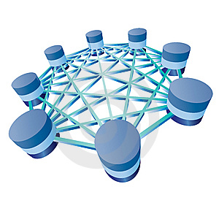
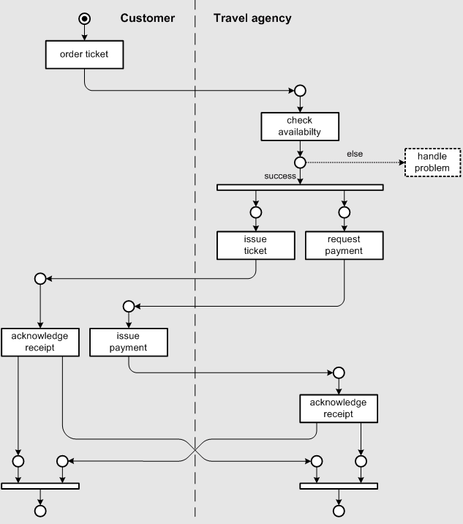
Task sequencing and verification
Task sequencing is a major difficulty for distributed systems
Difficulty to integrate workflow and database systems
Verification of temporal properties is hard
Typically verification is harder than evaluation
Evaluating an FO query is ptime data complexity
Verifying that Q ⊆ Q’ is undecidable
Verification will be the topic of the seminar by Victor Vianu
DBMSs exchanging data
Workflow systems sequencing tasks

Slide 36
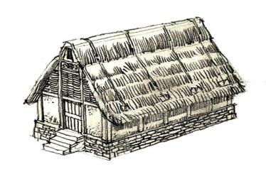
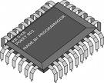
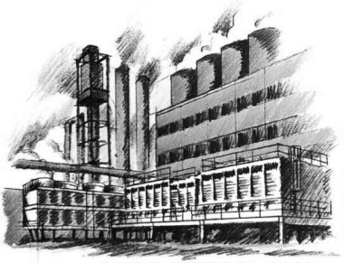
Example: Dell Supply Chain
Warehouse
Supplier
Shipping
Plant
Customer
Web Store
Bank

Slide 37
AXML as business artifacts
Concept introduced by IBM
[Nigam & Caswell 03, Hull & Su 07]
Data-centric workflows
A process is described by a document (possibly moving in the enterprise)
The behavior of an artifact is specified by some constraints on its evolution
Vs. state-transition-based workflows
Based on some form of state transition diagrams (BPEL, Petri,…)
Mostly ignore data
webOrder id=7787780
Customer
Name: John Doe
Address: Sèvres
Product: committed
Ref: PC 456
Factory: Milano
Parts: waiting
orderDate: 2009/07/24
Site: http:// d555.com
Payment: done
Bank-account …
Delivery: not-active

Slide 38
Axml Artifacts move between peers
In webStore In plant In delivery
webOrder id=7787780
Customer
Name: John Doe
Address: Sèvres
Order selection: on-going
Ref: PC 456
Factory: undecided
Parts: not-active
orderDate: 2009/07/24
Site: http://d555.com
Payment: pending
Delivery: not-active
webOrder id=7787780
Customer
Name: John Doe
Address: Sèvres
Order selection : committed
Ref: PC 456
Factory: Milano
Parts: on-going
orderDate: 2009/07/24
Site: http:// d555.com
Payment: done
Bank-account …
Delivery: not-active
webOrder id=7787780
Customer
Name: John Doe
Address: Sèvres
Order selection : committed
Ref: PC 456
Factory: Milano
Parts: done
orderDate: 2009/07/24
Site: http:// d555.com
Payment: done
Bank-account: CEIF-4457889
Delivery: on-going
Address: Orsay

Slide 39
catalogue
WEBSTORE
PLANT
DELIVERY
CREDIT APPROVAL
WAREHOUSE
ARCHIVE

Slide 40
Sequencing of operations
Different ways of expressing sequencing of tasks
Guards: preconditions for function calls
Transition-based diagrams
Formulas in temporal logic
Study how they can simulate each other using some “scratch paper”

Slide 41
A jewel of active documents
Casting document to a target type

Slide 42
The casting problem
Given
An active document I
The signature of the functions
And a target type T
Which functions to call to be sure to reach T?
2-player game
Juliet chooses which function to call
Romeo chooses a value within the domain of the function
Juliet wins if she can reach a document in T

Slide 43
An abstraction: active context-free games
On words instead of trees
Game (𝚺,R,T)
𝚺 is a finite alphabet
R set of CF rules
T is a regular target language
w is the start word
Output: true if Juliet has a winning strategy
Alternation of
∃ states (Juliet pick next function to call) and
∀ states (the adversary Romeo picks the answer)

Slide 44
Examples
Winning
Start word aba
Strategy
Call the second a
Call all the c’s
Obtain a word in Target
Losing
Start word ab
No strategy
Initially #(a) – #(b) = 0
If I call a or b, #(a) – #(b) < 0
a→abc*; b→(ba)*b; c→ab
Target abab(ab)*

Slide 45
Fun rewriting game
The problem is undecidable in general
Interesting decidable subcases
MuschollSchwentickSegoufin
Juliet has to traverse the string from left to right
No recursion among function calls
Function call are “linear”
Also in practice, very efficient casting based on unambiguous grammars

Slide 46
Conclusion

Slide 47
Some works around Axml
The Axml system – open-source (on server, on smartphone)
The useful: Replication and query optimization
How to evaluate a query efficiently by taking advantage of replication
The useful: Lazy query evaluation
How to evaluate a query without calling all embedded services
The fun: Casting problem
Which functions to call to “match” a target type
Active context-free games
The exotic
Diagnosis of communication systems based on datalog optimization
Access control
Distributed design
Probabilistic generation of documents

Slide 48
We will come back to distribution
Lesson 6: datalog - recursion is essential
Lesson 7: distributed data management in general
Lesson 8: distributed knowledge bases

Slide 49
Acknowledgements
With many colleagues, in particular:
Tova Milo (Tel Aviv) Victor Vianu (UCSD)
Luc Segoufin (INRIA) Ioana Manolescu (INRIA)
Georg Gottlob (Oxford) Alkis Polyzotis (UCSC)
Angela Bonifati (Lille) Marie-Christine Rousset (Grenoble)
Balder ten Catte (UCSC) Yannis Katsis (UCSD)
And PhD students
Omar Benjelloun (Google) Bogdan Marinoiu (SAP)
Pierre Bourhis (INRIA) Alban Galland (INRIA)
Marco Manna (Calabria) Nicoleta Preda (Versailles)
Zoe Abrams (Google) Emmanuel Taropa (Google)
Bogdan Cautis (Telecom) Spyros Zoupanos (Max-Planck-Institut)
And others

Slide 50
Merci !

Slide 51
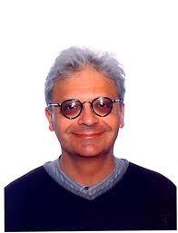
Static Analysis and Verification Victor Vianu, U.C. San Diego
PhD from USC 1983
Sabbaticals INRIA, ENS Cachan, Ulm, Telecom
Interests: database theory, computational logic, Web data
Co-author of Foundations of databases
Aka the Alice book
Vianu has served as
General Chair of SIGMOD, PODS,
Program Chair of PODS, ICDT
Editor-in-Chief of the J. ACM
ACM Fellow

