Slide 1
Static Analysis and Verification
in Databases
Victor Vianu
U.C. San Diego
Notes:
SA and V is a broad subject that touches upon many different areas of computer science.
It of crucial importance to databases, where it has developed its own set of specific techniques,
and this what I will focus on in this talk.

Slide 2
What is it?
Reasoning about queries and applications to guarantee
correctness
good performance
Notes:
Anyone who relies on a database knows that correctness and good performance are critical requirements

Slide 3
Important to experts ...
SQL queries
Expert user
Database Server

Slide 4
… but also to the public at large
Applications built on top of a database
Web sites: FNAC, Amazon, SNCF, Opodo, Facebook,…

Slide 5
… but also to the public at large
Applications built on top of a database
Web sites: FNAC, Amazon, SNCF, Opodo, Facebook,…
input

Slide 6
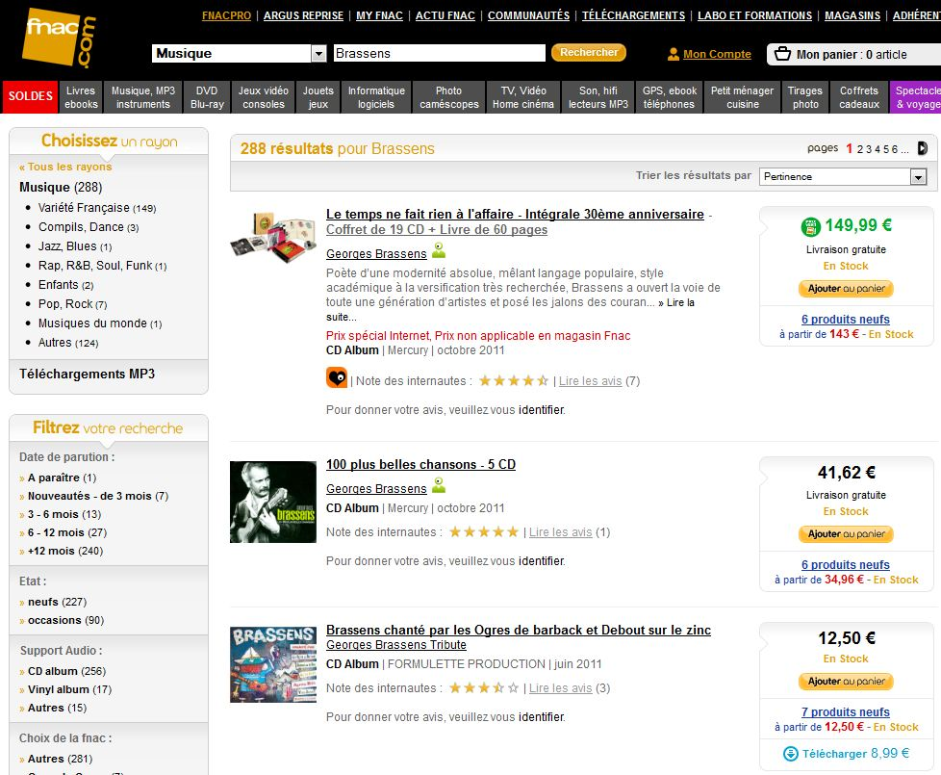
… but also to the public at large
Applications built on top of a database
Web sites: FNAC, Amazon, SNCF, Opodo, Facebook,…
input
output

Slide 7
… but also to the public at large
Applications built on top of a database
Web sites: FNAC, Amazon, SNCF, Opodo, Facebook,…
output

Slide 8
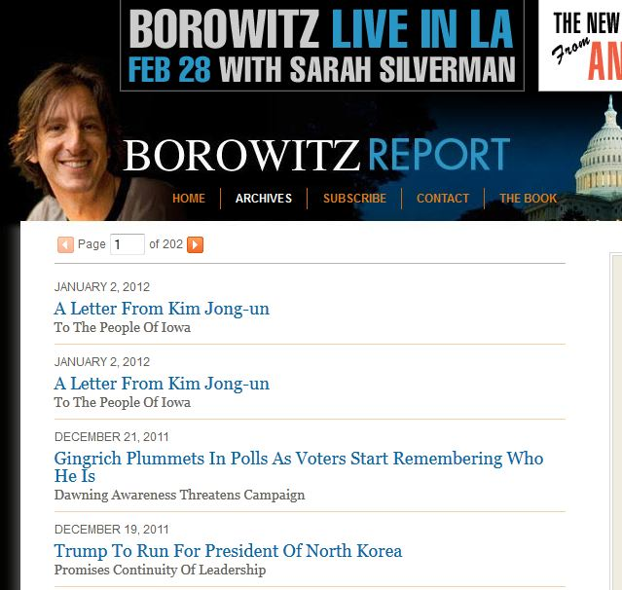
Wide array of bugs
Mildly annoying: duplicate news items

Slide 9
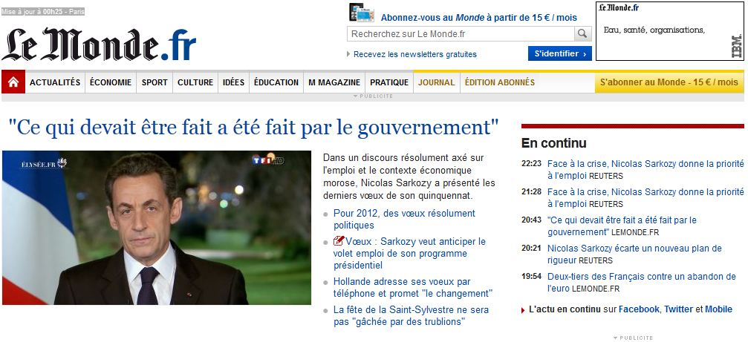
Wide array of bugs
Mildly annoying: duplicate news items

Slide 10
Wide array of bugs
Possible reason: a query returns duplicates

Slide 11
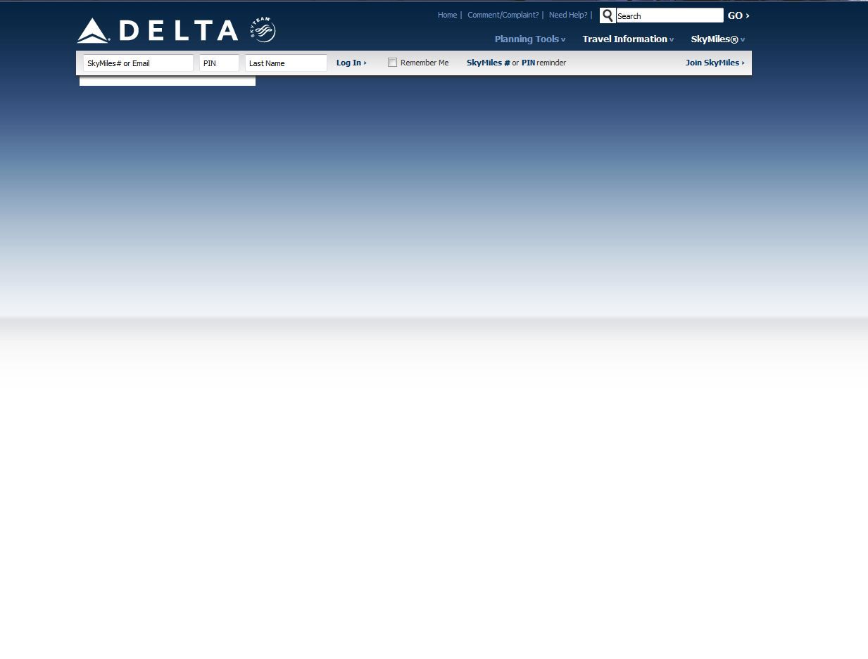
Wide array of bugs
Irritating: blank web page

Slide 12
Wide array of bugs
Possible reason: a query returns empty answer

Slide 13
Wide array of bugs
Irritating: wait forever

Slide 14
Wide array of bugs
Possible reason: query processing is too slow

Slide 15
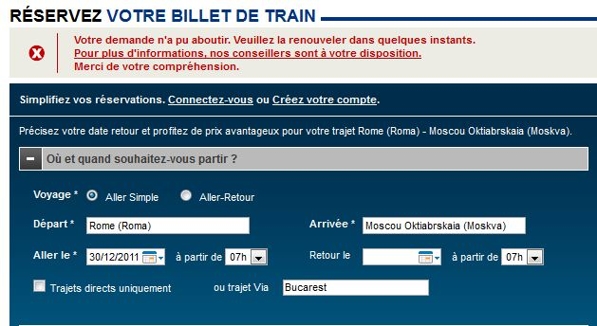
Wide array of bugs
Irritating: fail after long interaction

Slide 16
Wide array of bugs
Possible reason: poorly designed workflow

Slide 17
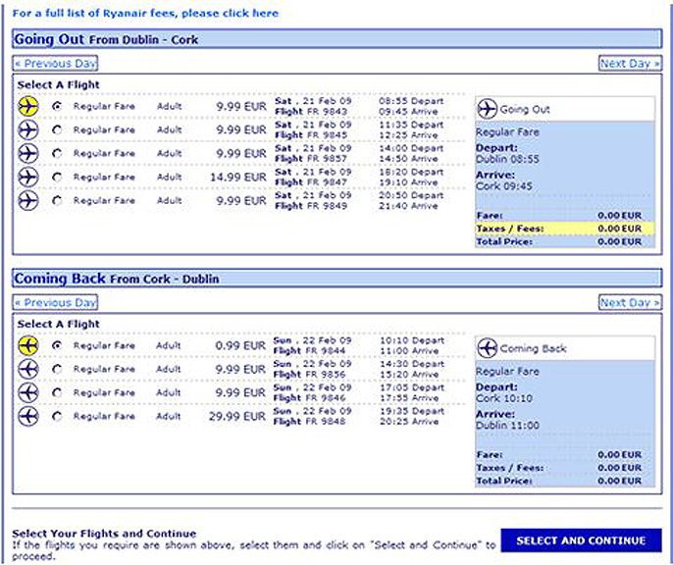
Wide array of bugs
Exhilarating/catastrophic: free ticket!

Slide 18
Wide array of bugs
Likely reason: flaw in workflow design

Slide 19
How can static analysis and verification help?
Static analysis
reasoning about queries
Verification
reasoning about workflow
Notes:
Workflow: sequence of steps in the interaction.
For example, static analysis can guarantee that a query does not return the empty answer, or duplicate tuples, or it can improve performance. Verification can guarantee that Ryan air does not sell tickets for free.

Slide 20
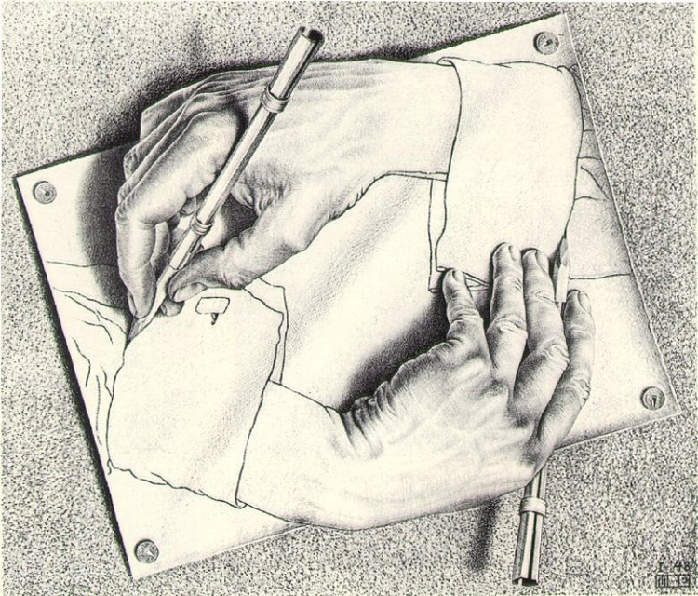
Static analysis
Query: “reasoning” about data
Static analysis: “reasoning” about the “reasoner”
program
query
Static analysis program
program
YES
NO
Notes:
Prototypical source of undecidability in computing

Slide 21
Static analysis
Self-reference: source of undecidability
program
query
Static analysis program
program
YES
NO
Notes:
Prototypical source of undecidability in computing

Slide 22
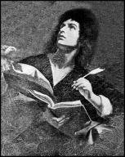
Static analysis
Self-reference: source of undecidability
Well, the truth is that P cannot possibly be, because if you wrote it and gave it to me, I could use it to set up a logical bind that would shatter your reason and scramble your mind.
……..
You can never find general mechanical means for predicting the acts of computing machines; it’s something that cannot be done. So we users must find our own bugs. Our computers are losers!
Geoffrey K. Pullum, University of Edinburgh
M, I
program
Halting problem
Is there a program P that,
given any program M with input I
outputs YES if M halts on I
and NO otherwise
program
P: does M halt on I ?
YES
NO
Notes:
The proof of the Halting Problem is so simple and elegant that it has become the stuff of popular culture.
It has been recited on stage in a Broadway play, and even put into verse.

Slide 23
Static analysis
Self-reference: source of undecidability
P, P
M, I
Flavor of the paradox
P: does M halt on I?
“This sentence is false”
P: does P halt on P ?
YES
NO

Slide 24
Static analysis
Self-reference: source of undecidability
P, P
Is this really relevant to SQL ?
M, I
P: does M halt on I?
P: does P halt on P ?
YES
NO

Slide 25
Static analysis
“Simple”, fundamental question:
Is the answer to Q always empty ?
select title
from Schedule
where theater = ‘Les Halles’
and theater = ‘Odeon’
‘Les Halles’ = ‘Odeon’
Schedule title theater time

Slide 26
Static analysis

Slide 27
Static analysis
select PROJECT.PNAME, EMPLOYEE.LNAME
from PROJECT, EMPLOYEE, WORKS_ON
where PROJECT.PNUMBER = WORKS_ON.PNO
and WORKS_ON.ESSN = EMPLOYEE.SSN and
not exists
(select * from DEPARTMENT, EMPLOYEE
where PROJECT.DNUM = DNUMBER or MGRSSN = SSN)
Always empty?

Slide 28
Static analysis
Surprise:
The Halting problem can be reduced
to the SQL query emptiness problem!
input I
Turing Machine M
SQL query Q_{M,I}
M halts on I
iff
Q_{M,I}(DB) ≠ ∅ for some database DB

Slide 29
Static analysis
Surprise:
The Halting problem can be reduced
to the SQL query emptiness problem!
SQL query emptiness is undecidable

Slide 30
Static analysis
Also undecidable:
Are two queries P and Q equivalent?
Can Q be simplified (relative to various criteria)
Does query Q ever return duplicate tuples?
Any non-trivial property!
Is there a class of simpler but useful
SQL queries amenable to static analysis?

Slide 31
Well-behaved case: Conjunctive Queries
select … from … where…
conjunction of equalities
on attributes and constants
select theater
from Movie, Schedule
where director = ‘Godard’ and
Movie.title = Schedule.title
Movie title director actor
Schedule title theater time
Notes:
CQs: the paradise of static analysis

Slide 32
Well-behaved case: Conjunctive Queries
Query emptiness: easy to check
select title
from Schedule
where theater = ‘Les Halles’
and theater = ‘Odeon’
‘Les Halles’ = ‘Odeon’

Slide 33
Well-behaved case: Conjunctive Queries
Useful fact: if non-empty, can represent intuitively as a simple pattern of tuples using variables and constants
select theater
from Movie, Schedule
where director = ‘Godard’ and
Movie.title = Schedule.title
Movie title director actor
Schedule title theater time
t Godard
t a
Answer theater
Query result
a

Slide 34
Well-behaved case: Conjunctive Queries
Unsettling thought: this query is a database!
Can I apply a query to a query ?
Movie title director actor
Schedule title theater time
t Godard
t a
Answer theater
a
Notes:
CQs are chameleons: they can act as queries or as databases as needed

Slide 35
Well-behaved case: Conjunctive Queries
Unsettling thought: this query is a database!
Can I apply a query to a query ?

Slide 36
Well-behaved case: Conjunctive Queries
Good news: powerful tool for static analysis!

Slide 37
Well-behaved case: Conjunctive Queries
Query equivalence
P
Q
answer
answer
DATABASE
Notes:
Dual role as a query and as a database

Slide 38
Well-behaved case: Conjunctive Queries
Query equivalence
P
Q
DB
answer
answer
Notes:
Dual role as a query and as a database

Slide 39
Well-behaved case: Conjunctive Queries
Query equivalence
P
Q
DB
answer
answer
Notes:
Dual role as a query and as a database

Slide 40
Well-behaved case: Conjunctive Queries
Query equivalence
Example: db is a binary relation (graph)
P
Q
b
x y
c
x a y
x y
x y

Slide 41
Well-behaved case: Conjunctive Queries
Query equivalence
Example: db is a binary relation (graph)
P
Q
b
x y
c
x a y
x y
x y

Slide 42
Well-behaved case: Conjunctive Queries
Query equivalence
Example: db is a binary relation (graph)
P
Q
equivalent
b
x y
c
x a y
x y
x y

Slide 43
Well-behaved case: Conjunctive Queries
One step further: taking into account constraints
P
Q
DB
DB
Force Σ
Force Σ
answer
answer
DATABASE
constraints Σ
Notes:
Dual role as a query and as a database

Slide 44
Well-behaved case: Conjunctive Queries
One step further: taking into account constraints
P’
Q’
equivalence
test
answer
answer
Notes:
Dual role as a query and as a database

Slide 45
Well-behaved case: Conjunctive Queries
Forcing satisfaction of Σ: the Chase
P
DB
Force Σ
answer

Slide 46
Well-behaved case: Conjunctive Queries
Forcing satisfaction of Σ: the Chase
Movie title director actor
Schedule title theater time
b Godard
b a
c Bardot
c a
Answer theater
a
Σ
theater title
title director

Slide 47
Well-behaved case: Conjunctive Queries
Forcing satisfaction of Σ: the Chase
Movie title director actor
Schedule title theater time
b Godard
b a
b Bardot
b a
Answer theater
a
Σ
theater title,
title director

Slide 48
Well-behaved case: Conjunctive Queries
Forcing satisfaction of Σ: the Chase
Movie title director actor
Schedule title theater time
b Godard
b a
b Godard Bardot
b a
Answer theater
a
Σ
theater title
title director

Slide 49
Well-behaved case: Conjunctive Queries
Forcing satisfaction of Σ: the Chase
Movie title director actor
Schedule title theater time
b Godard Bardot
b a
Answer theater
a
Σ
theater title
title director

Slide 50
Well-behaved case: Conjunctive Queries
How far does the good news go?
Trouble in paradise: an undecidable question
Implication of CQ inclusion
P₁ ⊆ Q₁
P₂ ⊆ Q₂
….
P_{n} ⊆ Q_{n}
implies
P ⊆ Q
reduction from word problem
for finite monoids

Slide 51
Well-behaved case: Conjunctive Queries
How far does the good news go?
Trouble in paradise: an open question
Does the answer to P determine the answer to Q?
DB
P
answer
Q
Decidability is open!
?
Example:
P(x,y): path of length 2
Q(x,y): path of length 3
Example:
P(x,y): path of length 2
Q(x,y): path of length 4
P₃(x,y): path of length 3
P₄(x,y): path of length 4
Q(x,y): path of length 5
answer

Slide 52
Summary so far
SQL: too powerful for decidable static analysis
Conjunctive queries: simple SQL queries, well behaved
Not enough:
static analysis of complex queries
is essential to performance!
Notes:
Example [Bill McKenna, ParAccel]:
“monster query” produced by a tool: 23 000 lines of SQL

Slide 53
What to do in practical query processing
Static analysis on simple building blocks
Complex SQL query

Slide 54
What to do in practical query processing
Static analysis on simple building blocks
π
∪
π
σ
∅

Slide 55
What to do in practical query processing
Static analysis on simple building blocks
π
∪
π
σ
∅
∅

Slide 56
What to do in practical query processing
Static analysis on simple building blocks
π
∪
π
σ
∅
∅

Slide 57
What to do in practical query processing
Static analysis on simple building blocks
π
∪
π
∅
∅

Slide 58
What to do in practical query processing
Static analysis on simple building blocks
π

Slide 59
What to do in practical query processing
Rewrite rules for simplifying queries
early selection
π_{theater}
π_{theater}
σ_{dir =} _{Godard}
schedule
σ_{dir =} _{Godard}
schedule movie
movie

Slide 60
What to do in practical query processing
Many other heuristics
Dramatic impact on complex queries
More rewrite rules, subquery decorrelation,
common subqueries, view unfolding …
Example [Bill McKenna, ParAccel]:
23 000 lines “monster query”
static analysis improved performance by 95%

Slide 61
Static analysis for XML
Questions: some similar, some new
Different techniques
XML Schema is closely related to tree automata
XQuery is closely related to tree transducers
Techniques for XML:
mix of logic and automata theory
Important twist due to data:
automata on infinite alphabets

Slide 62
Static analysis
reasoning about queries
Verification
reasoning about workflow

Slide 63
Verification of application workflows
Example: verify that no free tickets can be sold

Slide 64
Automatic verification problem
Specification
Property
VERIFIER
YES
NO, counterexample

Slide 65
Verification of application workflows
input
output

Slide 66
Verification of application workflows
High-level specification: First-Order logic (FO) control
FO CONTROL
input
output

Slide 67
Verification of application workflows
High-level specification: FO control
FO CONTROL
input
output

Slide 68
Verification of application workflows
High-level specification: FO control
RUN
input
input
input
….
output
output
output

Slide 69
Verification of application workflows
Specifying properties
always ( ticket-delivered → previously (ticket-paid))
Every delivered ticket has been previously paid
in the correct amount
ticket-paid
ticket-delivered
….

Slide 70
Verification of application workflows
Specifying properties
∀x
always ( ticket-delivered → previously (ticket-paid))
deliver(x)
∃y (pay(x,y) ∧ price(x,y))
output
input DB

Slide 71
Verification of application workflows
Specifying properties
always ( ticket-delivered → previously (ticket-paid))
Language for properties: FO + temporal operators

Slide 72
Formal verification problem
Specification
Property
VERIFIER
YES
NO, counterexample
Good news: Can automatically verify
significant classes of applications
Techniques:
mix of logic and automata theory

Slide 73
Variant for AXML
AXML system
Property
VERIFIER
YES
NO, counterexample

Slide 74
Variant for AXML
∀x
Every delivered ticket has been previously paid
in the correct amount
always ( ticket-delivered → previously (ticket-paid))
Mail-Order-Center
Ticket-Center
Ticket-Center
Product
Order
Ticket
Ticket
Order
Delivered
Price
Customer
Product
Number
Number
Price
Payment
∀x
X
Y
Z
X
X
Y
Y
Z
X
Y

Slide 75
Variant for AXML
AXML system
Property
VERIFIER
YES
NO, counterexample
Good news, again: can automatically verify significant classes of applications

Slide 76
Conclusions
Static analysis and verification in databases:
Practically essential, intellectually challenging
Run against fundamental limitations of computing
Deep mathematics, elegant mix of logic and automata theory
This talk: limited overview of some basic questions and ideas
Just the tip of the iceberg:
Many more static analysis and verification problems
Wide array of techniques to deal with limitations: sophisticated heuristics, approximation, abstraction
Notes:
Touches upon … this means that there are many useful tasks that cannot be done by computers. What can be done uses deep mathematics, ….
End: So, there is much much more to be learned about this fascinating field

Slide 77
Work on verification
UC San Diego:
Alin Deutsch & DB team
INRIA & ENS Cachan:
Serge Abiteboul and Luc Segoufin

Slide 78
Thank you!
Merci!

