Slide 1
The Semantic Web
Serge Abiteboul
INRIA Saclay, Collège de France, ENS Cachan

Slide 2
Organization
Introduction
Ontologies
Querying ontologies
Integrating data sources

Slide 3
Introduction

Slide 4
The goals
First step from a web of text (for humans) to a web of knowledge (for machines)
Attach semantics to information published on the web
Improve precision of query results
Facilitate integration of data sources
Difficulties
Mismatch between structured and unstructured data
Heterogeneity between data sources
Imprecision, incompleteness, possibly inconsistencies of information

Slide 5
The semantic web
The Semantic web is an evolving extension of web standard to introduce semantics
Standards of the W3C:
Naming entities: URI
Facts/relations: RDF
Constraints on them: RDF/S or OWL
Linked data
Queries: SPARQL

Slide 6
Uniform resource identifiers
The web talks about resources
A resource is anything on the Internet that can be referred to by a Uniform Resource Identifier (URI), i.e., a string of characters
A web page, identified by a URL
A fragment of an XML document
A web service,
A thing, an object, a concept, a property, etc.
Resources are described using semantic annotations: logical assertions that relate resources to some terms in pre-defined ontologies

Slide 7
Ontologies

Slide 8
Ontologies
Descriptions providing a shared understanding of a given domain
A controlled vocabulary
Understandable by humans
Formally defined so that it can also be processed by machines
Logical semantics to enablea reasoning
Reasoning is essential for
Better answering
more precise answers
refining queries with too many answers
relaxing queries with no answer
Better integrating data sources
Relating objects in different data sources enabling their integration
Detecting/resolving inconsistencies or redundancies

Slide 9
Classes and class hierarchy
CS Dept isa Department
A taxonomy: a hierarchy of classes
Staff
Department
Student
Course
Admin
Staff
Acad
Staff
CS
Dept
Maths
Dept
Physics
Dept
PhD
Stud
Master
Stud
Undergrad
C S
Course
Logic
Maths
Course
Mike.Jones
Anne.Doe
Java
AI
DB
Algebra
Proba
Objects in these classes

Slide 10
Instance of a class
A class is interpreted as a set of objects
Mike.Jones instanceOf AcademicStaff
AcademicStaff (Mike.Jones)
The relation isa is interpreted as set inclusion
AcademicStaff isa Staff
∀x ( AcademicStaff(x) ⇒ Staff(x) )
Inference
Staff (Mike.Jones)
Person
Staff
Academic
Staff

Slide 11
Relations
Declaration of relations with their signatures
TeachesIn(AcademicStaff, Course)
TeachesTo(AcademicStaff, Student),
Leads(Staff, Department)
Instances of relations
Relations are interpreted as binary relations between objects
TeachesIn(Mike.Jones, Java)
∀x,y ( TeachesIn(x, y) ⇒ AcademicStaff(x) ⋀ Course(y) )

Slide 12
Ontology = schema + instance (aka Knowledge base)
Database schema
The class hierarchy
The set of class names and the isa relation
The signatures of relations
Other constraints that are used for
checking data consistency (like dependencies in databases)
inferring new facts
Database instance
The set of base facts that forms the database
The set of facts that may be inferred

Slide 13
Ontology languages
RDF: to describe facts
RDFS: to define simple ontologies about RDF facts
OWL: a richer ontology language
We present them rapidly
We mention a family of ontology languages, description logics
OWL may be seen as a syntax for a description logic

Slide 14
RDF triples
Leads
Dupond
CSDept
Subject Predicate Object
In English: Dupond leads the CS department
In Logic: Leads(Dupond,CS department)
More triples < Dupond TeachesIn UE111 > < Dupond TeachesTo Pierre >
< Pierre EnrolledIn CSDept > < Pierre RegisteredTo UE111 >
With web resources:
http://univ.com/Leads
http://a.fr/Dupond
http://univ.com/CSDept

Slide 15
Beyond binary relations Enrolment(Pierre, CSDept, A)
Student | Department | Grade
Pierre | CSDept | A
Enrol345
Enrol345 | Student | Pierre
Enrol345 | Department | CSDept
Enrol345 | Grade | A
student
department
grade
Pierre
CSDept
A
Rather inelegant? Yes

Slide 16
RDF graph
A set of RDF facts defines an RDF graph
where the nodes are objects
CSDept
Leads
EnrolledIn
TeachesTo
OfferedBy
Dupond
Pierre
RegisteredTo
TeachesIn
UE211

Slide 17
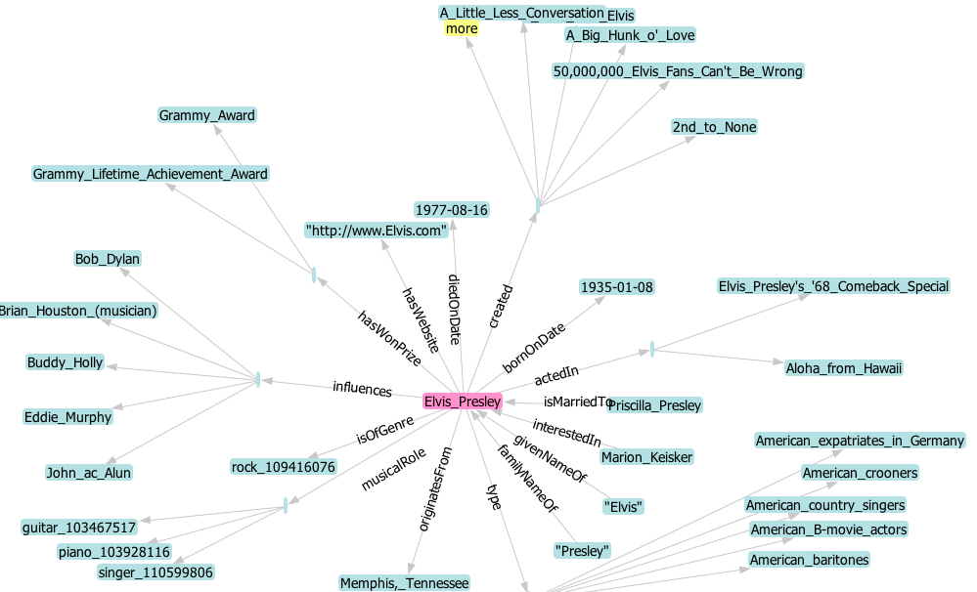
Example of an RDF Graph: Elvis in Yago

Slide 18
The RDF graph is global
a.fr
http://a.fr/age
29
http://a.fr/fn
http://a.fr/Dupond
Alice
univ.com
http://univ.com/Leads
http://a.fr/Dupond
http://univ.com/CSDept

Slide 19
Some standard vocabularies
rdf: The basic RDF vocabulary
rdfs: RDF Schema vocabulary
dc: Dublin Core (predicates for describing documents)
s: Schema.org (predicates for describing web content)
Vocabulary for people, movies, events, etc
cc: Creative Commons (types of licenses)

Slide 20
RDFS: RDF Schema
The schema in RDF is super simplistic
An RDF Schema defines the schema of a richer ontology
Do net get confused
RDFS can use RDF as syntax
I.e., RDFS statements can be expressed as RDF triples using RDFS keywords for properties and objects

Slide 21
Examples for RDF Schema – using RDF syntax
Declaration of classes and subclass relationships
< Staff rdf:type rdfs:Class > < Java rdfs:subClassOf CSCourse >
Declaration of instances
< Dupond rdf:type AcademicStaff >
Declaration of relations
< RegisteredTo rdf:type rdf:Property >
Declaration of subproperty relationships
< LateRegisteredTo rdfs:subPropertyOf RegisteredTo >
Declaration of domain/range restrictions for predicates
< TeachesIn rdfs:domain AcademicStaff >
< TeachesIn rdfs:range Course >
i.e. TeachesIn( AcademicStaff , Course)

Slide 22
Owl
OWL extends RDFS with the possibility to express additional constraints
Disjointness between classes
Constraints of functionality and symmetry on predicates
Intentional class definitions
Class union and intersection
Examples
Departments can be lead only by professors
Only professors or lecturers may teach to undergraduate students.

Slide 23
Description Logics
Philosophy: isolate decidable fragments of first-order logic allowing reasoning about classes and binary relations
These fragments are called Description Logics
The DL jargon:
the classes are called concepts
the properties are called roles
the schema is called the Tbox
the instance is called the Abox
the ontology = Tbox + Abox

Slide 24
Semantics of main concepts
I(C1 ⊓ C2) = I(C1) ∩ I(C2)
I(∀R.C) = {o1 | ∀ o2 [(o1,o2) ∈ I(R)⇒o2 ∈ I(C)]}
I(∃R.C) = {o1 | ∃o2.[(o1,o2) ∈ I(R) ∧ o2 ∈ I(C)]}
I(¬C) = dom(I) － I(C)
I(R⁻) = {(o2,o1) | (o1,o2) ∈ I(R)}

Slide 25
The kind of questions that are considered
Satisfiability checking: Given an ontology
K = <T ,A>, is K satisfiable?
I.e., is the ontology consistent? does there exist a possible world?
Subsumption checking: Given a Tbox T and two concept expressions C and D, does T ⊨ C ⊑ D?
I.e.. is C a subclass of C’ in any possible world
Instance checking: Given an ontology K = <T ,A>, an individual e and a concept expression C, does K ⊨ C(e)?
Query answering: Given an ontology K = <T ,A>, and a concept expression C, finds the set of individuals e such that K ⊨ C(e)?
These problems are undecidable for full OWL

Slide 26
Querying ontologies

Slide 27
Querying using RDFS
RDFS statements can be used to infer new triples
Example
Base fact ResponsibleOf (durand,ue111)
Rule: ResponsibleOf (X,Y)⇒Professor (X)
rule Professor (X)⇒AcademicStaff (X)
If we ask the query “who is in the Academic Staff?”, we want Durand in the answer
For this, we can use inference by saturation
Keep inferring new facts until a fixpoint is reached
Only polynomially many facts can be added
In ptime

Slide 28
More complex languages: description logics
Develop as a good compromise between expressive power and reasonable complexity of query answering
Example: dl-light also in ptime but much richer
Avoid saturation by using query reformulation

Slide 29
Answering queries by reformulation
Professor(Jim), HasTutor(John,Mary), TeachesTo(John,Bill)
HasTutor (y,z)←Student (y)
Student ⊑ ∃HasTutor in DL jargon
Query q0: q0(x)←TeachesTo(x,y) ∧ HasTutor (y,z)
Query q1 computes answers to q0:
q1(x)←TeachesTo(x,y) ∧ Student (y)
One can use standard query processors to answer the query

Slide 30
Difficulties
For some logics, reformulation is not possible
For some logics, inconsistencies
It may be the case that there is no model satisfying all the statements

Slide 31
SPARQL
http://univ.com/leads
http://a.fr/Dupond
?dep
SPARQL (SPARQL Protocol and RDF Query Language) is a query language for RDF
SELECT ?dep
WHERE {
<http://a.fr/Dupond> <http://univ.com/leads> ?dep }
Find me all the values for ?dep such that the triple is true
Pattern matching over the RDF graph
Many gadgets
Some ontologies provide “SPARQL endpoints”, i.e. a service than can
receive SPARQL queries sent by a machine or typed by a human

Slide 32
Integration of data sources

Slide 33
Goal
Obtain data from different data sources with a single query/interface
The data source have been developed independently, are autonomous and heterogeneous
Example:
Sciences: query different genetic databases
Business: query different catalogs from different vendors
Accounting: integrate financial data from different branches
Use semantics to describe connections between data sources
Specify links
Specify views

Slide 34
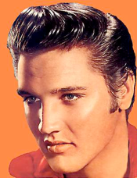
Specify links
Many ontologies talk about the same entity with different URIs
This is bad, because we cannot join the information
guitar
singer
plays
rdf:type
born
1935
DBpedia
(http://dbpedia.org/ )
Elvisopedia
(http://elvisopedia.org/ )

Slide 35
Specify links
OWL provides vocabulary to link equivalent entities
http://elvisopedia.org/Elvis owl:sameAs http://dpbedia.org/Elvis
guitar
singer
plays
rdf:type
born
owl:sameAs
1935
DBpedia
(http://dbpedia.org/ )
Elvisopedia
(http://elvisopedia.org/ )

Slide 36
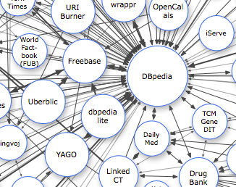
Specify links: The Linking Data Project
The Linking Open Data Project aims to interlink all open RDF data sources into one gigantic RDF graph

Slide 37
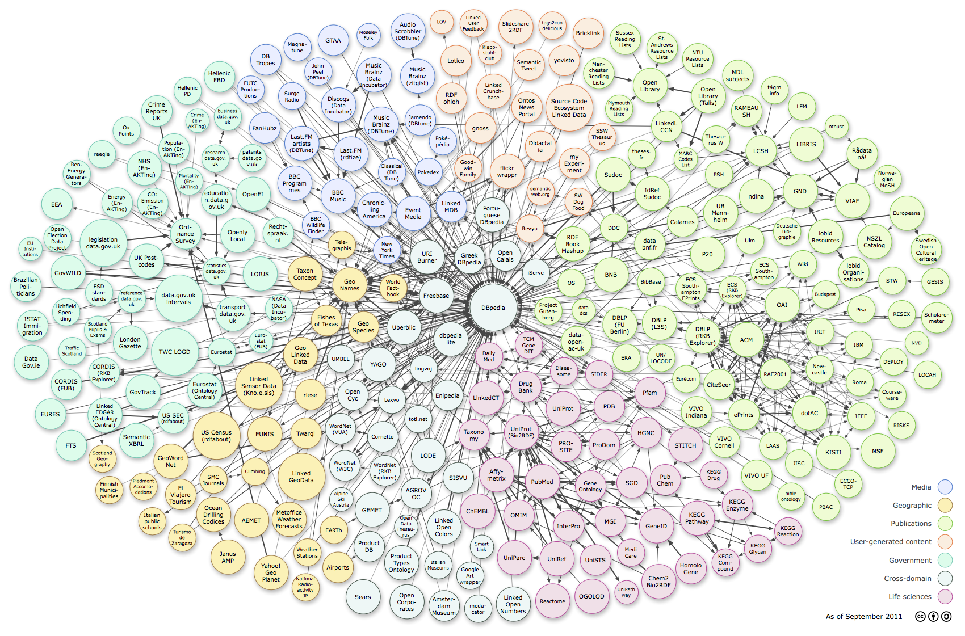
Specify links: The Linked Data Cloud
As of 2011: 295 ontologies, 25 billion triples, 400m links
http://richard.cyganiak.de/2007/10/lod/imagemap.html

Slide 38
Specify views
Recall
Query
Mediating approach
Global instance is virtual
Query: cost of reformulation
Creation and updates: no cost
Warehousing approach
Global instance is materialized
Query evaluation is very efficient
Updates are costly
Mediator
Queries/
Answers
Query
Warehouse
Load

Slide 39
Specify views
Recall
Local-As-Views (LAV) approach: the local relations are defined as views over the global relations
Query processing
Rewriting the users queries (expressed using global relations) in terms of local relations⇒ logical query plans
Combine the answers of logical query plans to obtain the result
Global-As-Views (GAV) approach: the global relations are defined as views over the local relations

Slide 40
Algorithms
Several algorithms have been proposed
Bucket
Minicon: an optimization of Bucket
Inverse-rules: in the spirit of algorithm for GAV
(less efficient but simple to explain)

Slide 41
A jewel of data integration
The bucket algorithm
By example

Slide 42
Setting
Input
A set of local relations defined as conjunctive views over the global schema
A conjunctive query over the global schema
Output
A set of conjunctive queries over the local relations that answers the query

Slide 43
Example
Global schema
Student(studentName), University(uniName), Program(title), MasterProgram(title), Course(code), EnrolledIn(studentName,title), EnrolledInCourse(studentName, code), PartOf(code,title), RegisteredTo(studentName, uniName), OfferedBy(title, uniName)
Rules
S1.Catalogue(U,P) :- FrenchUniversity(U), Program(P), OfferedBy(P,U), OffereBy(P’,U), MasterProgram(P’),
S2.Erasmus(S,C,U) :- Student(S), EnrolledInCourse(S,C), PartOf(C,P), OfferedBy(P,U), EuropeanUniversity(U), RegisteredTo(S,U’), EuropeanUniversity(U’), U≠U’
S3.CampusFrance(S,P,U) :- NonEuropeanStudent(S), EnrolledInProgram(S,P), Program(P), Offeredby(P,U), FrenchUniversity(U), RegisteredTo(S,U)
S4.Mundus(P,C) :- MasterProgram(P), OfferedBy(P,U), OfferedBy(P,U’), EuropeanUniversity(U), NonEuropeanUniversity(U), PartOf(C,P)

Slide 44
Example
q(x) :- RegisteredTo(s,x), EnrolledIn(s,p), MasterProgram(p)
We use the view definition
S3. CampusFrance(S,P,U) :-
NonEuropeanStudent(S), EnrolledIn (S,P),
Program(P), Offeredby(P,U), FrenchUniversity(U),
RegisteredTo(S,U)
We record that
Bucket(RegisteredTo(s,x)) contains S3.CampusFrance(s, v1,x)

Slide 45
Combining the buckets
q(x) :- RegisteredTo(s,x), EnrolledIn(s,p), MasterProgram(p)
Combining the buckets
Bucket(RegisteredTo(s,x)) = { S3.CampusFrance(s, v1,x) }
Bucket(EnrolledInProgram(s,p)) = {S3.CampusFrance(s, p,v2) }
Bucket(MasterProgram(p)) = { S1.Catalogue(v3,v4), S4.Mundus(p,v5) }
2 candidate rewritings:
r1(x) :- S3.CampusFrance(s, v1,x), S3.CampusFrance(s, p,v2), S1.Catalogue(v3,v4)
r2(x) :- S3.CampusFrance(s, v1,x), S3.CampusFrance(s, p,v2), S4.Mundus(p,v5)

Slide 46
Testing the candidates
Homomorphism Theorem
q(x) :- RegisteredTo(s,x), EnrolledIn (s,p), MasterProgram(p)
r1(x) :- S3.CampusFrance(s, v1,x), S3.CampusFrance(s, p,v2),
S1.Catalogue(v3,v4)
Expand(r1(x)) :- NonEuropeanStudent(s), EnrolledIn(s,v1),
Program(v1), Offeredby(v1,x), FrenchUniversity(x), RegisteredTo(s,x), EnrolledIns,p), Program(p), Offeredby(p,v2), FrenchUniversity(v2), RegisteredTo(s,v2), FrenchUniversity(v3), Program(v4),
OfferedBy(v4,v3), OffereBy(v5,v3), MasterProgram(v5)
Expand(r1(x)) ⊈ q(x) r1 is not a valid rewriting
test that r2 is one

Slide 47
Conclusion
More and more structured information
on the web

Slide 48
More and more semantic on the web
E.g., the UK government makes much of its data available online in RDF – by law
Enriching the standard web
Publishing semantic descriptions of web services/pages
Microdata an upcoming W3C standard to annotate HTML pages with RDF data
web applications and search engines start using such semantic annotations
The DBpedia Mobile App retrieves data from the Linked Open Data Cloud to show places of interest around you

Slide 49
More and more structured data on the web
More and more structured data published notably public
Lots of tables in html or pdf
Lots of data in deep web behind forms
Typically better quality than unstructured data
Many ontologies: e.g., DBPedia or Yago
Need: tools for searching, visualization, linking, integration

Slide 50
Building ontologies
Extract one from existing text sources
Yago built from Wikipedia
Difficult: Natural language processing is complex
Have humans collaborate to build it
Freebase: Freebase is an open, Creative Commons licensed graph database with millions of entities
Linked data: publish RDF links between web data
Integrate different ontologies by aligning their concepts and relations
Paris [SuchanekAbiteboulSenellart]

Slide 51
More reasoning
The scalability of reasoning on web data requires light-weight ontologies
Reasoning should be feasible – polynomial
Preferable if query answering can be performed with a relational database engines
RDFS is OK but too limited
Full OWL is too complex

Slide 52
References
Web data management,
Abiteboul, Manolescu, Rigaux, Rousset, Senellart
webdam.inria.fr/Jorge
Semantic web, Fabian Suchanek,
suchanek.name/work/teaching/inf347/inf347_sw.ppt

Slide 53
Merci !

Slide 54
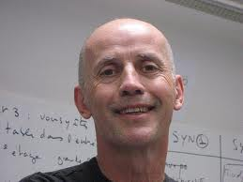
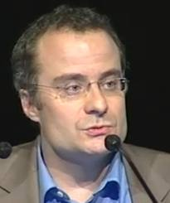
Ouverture des données publiques
François Bancilhon
Archivage du Web
Julien Masanès
Informaticien & PDG
Carrière académique
INRIA, MCC, Paris Sud
Encore un des plus cités en BD
Carrière industrielle
Fondateur ou dirigeant de O2 Technology , Arioso, Xylème, Ucopia, Mandriva, Data Publica
Dirige l'Initiative Services Mobiles pour l'INRIA
CEO de Data Publica
Conservateur de bibliothèque & Directeur
A été en charge de l’archivage du web à la BNF
Fondateur de l’« International Internet Preservation Consortium »
Fondateur de l’« International Web Archiving Workshop »
Directeur de la Fondation « Internet Memory »

