Slide 1
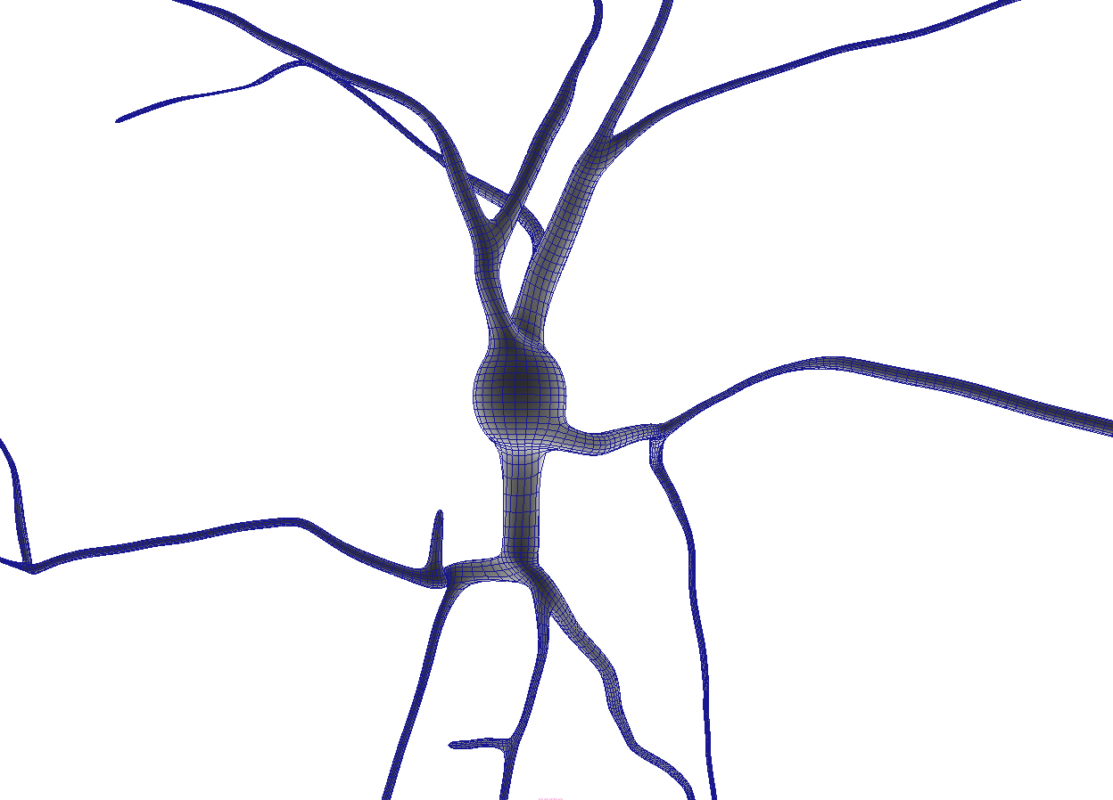

scientific data management: not your everyday transaction
Anastasia Ailamaki
Data-Intensive Applications and Systems (DIAS) Laboratory
School of Computer and Communication Sciences

Slide 2
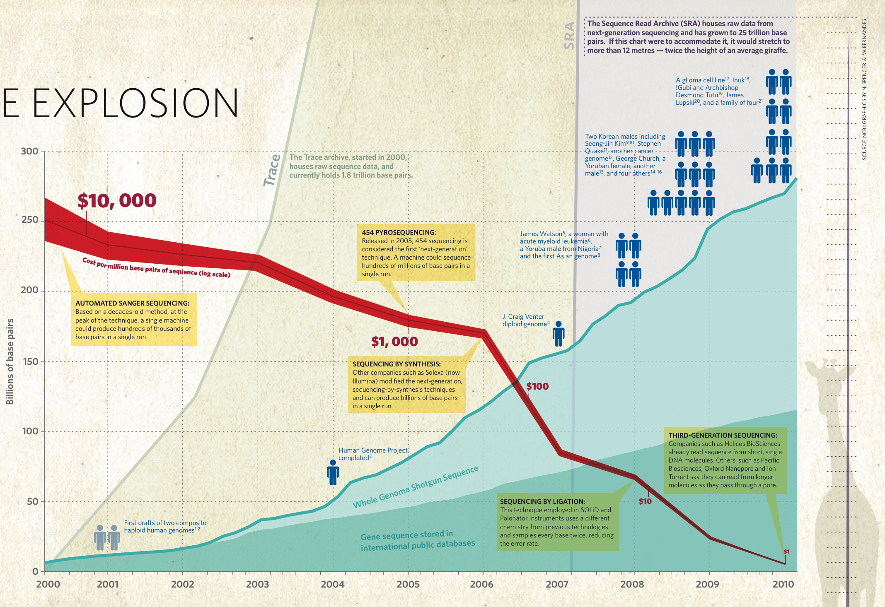
the human genome at ten (nature, 4/2010)
THE
SEQUENCE
EXPLOSION
TRACE
Sequence Read Archive
COST
WHOLE GENOME
but, benefits hindered by complexity

Slide 3
scientific data grows much faster than technology
collected data
data processing technology
1998 2000 2002 2004 2006 2008 2010 2012
WinterCorp Survey, www.wintercorp.com

Slide 4
scientific data management now
legacy software
in main memory of supercomputers
databases too rigid to use
As data grows, problem changes
difficult and slow
some data discarded
bridge CS and domain sciences

Slide 5
meeting domain scientists
“Hello, we’re SO HAPPY to meet you. We have SO MUCH data! PLEASE come visit!”
visit lab, pretty pictures (we have SO MUCH data)
“Let’s have lunch!” (we have SO MUCH data)
revisit lab, receive promise to get some data
ask for data, no reply
play DBA (design/normalize schema, design data, write queries, rewrite queries, talk to tech staff)
ask for data, receive 2GB
repeat (6), then ask again for data, receive 4GB

Slide 6
why collaboration is hard
Data is their achievement
  They do not understand what we will do with it
  They are afraid of what we may do with it
  They think that we will put it on the internet
They are not sure how we will help them
  Do not recognize their problems in our demos
They have been “burned” before
support work builds foundation!

Slide 7
It takes around 18 months of discussing and learning about a scientific application and dataset (while providing DBA services) until a problem which calls for true innovation reveals itself.

Slide 8
ORGANIZING scientific DATA

Slide 9
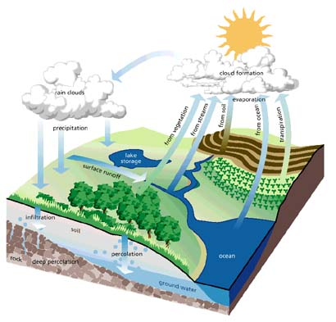
hydrological cycling, 1997
data-centric scientific workflow
enactment from within DBMS

Slide 10
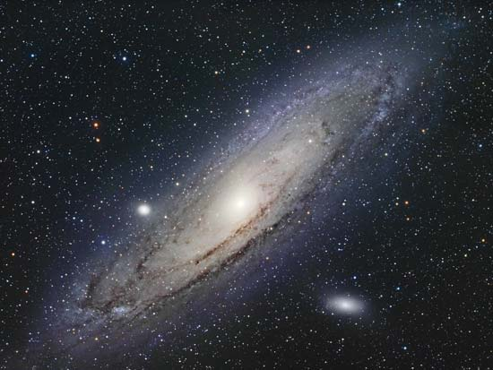
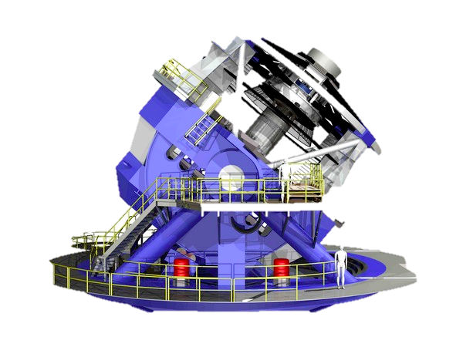
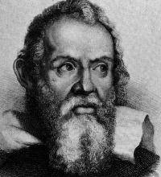
the large synoptic array telescope, 2017
date | time | type | category | Cx | Cy | Cz | …
mon | 22:00 | star | proto | … | … | … | …
mon | 22:15 | star | red giant | … | … | … | …
mon | 22:20 | galaxy | spiral | … | … | … | …
mon | 22:27 | star | dwarf | … | … | … | …
mon | 23:00 | galaxy | elliptical | … | … | … | …
tue | 22:10 | galaxy | spiral | … | … | … | …
tue | 22:25 | star | proto | … | … | … | …
tue | 22:30 | star | proto | … | … | … | …
tue | 22:45 | star | neutron | … | … | … | …
tue | 23:10 | galaxy | spiral | … | … | … | …
tue | 23:35 | galaxy | elliptical | … | … | … | …
tue | 00:30 | star | dwarf | … | … | … | …
index on “type”
Fast-moving galaxies?
… | … | … | … | … | … | … | …
… | … | … | … | … | … | … | …
… | … | … | … | … | … | … | …
… | … | … | … | … | … | … | …
100 billion objects, 20 PB/night
picture from the Sloan Digital Sky Survey, www.sdss.org

Slide 11
PARINDA DB designer
Workload
Index
Suggested
Rewritten
Suggested
On
-
line
Speedup
Interaction
Indexes
Workload
Partitions
Indexes
Index
Constraints
Auto
Partitions
Interaction
Indexing
Workload
Constraints
Indexes
Interactive
AutoPart
Workload
COLT
Workload
Partitioning
INUM cache with plans
a
Original
&Indexing
a
Original
Schema
Schema
What-if
What-if
What-if
COLT
Join
Table
Index
Cold
Hot
Materialized
PostgreSQL

Slide 12
Implementing physical MODELS

Slide 13
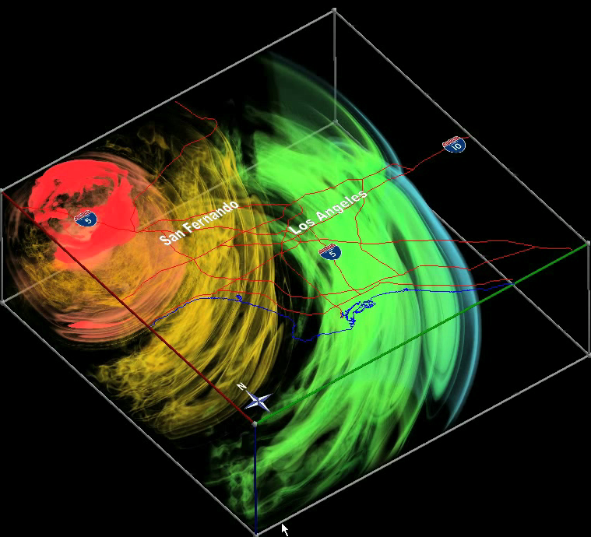
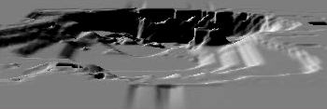
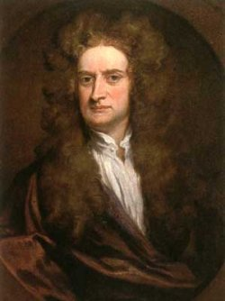
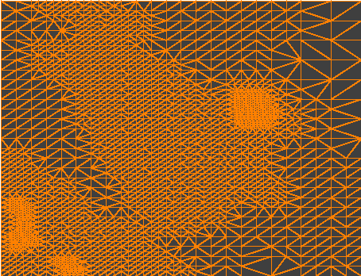

earthquake simulation/analysis
Quake Group [www.cs.cmu.edu/~quake]
Scientist
Analyze time = 50s
Simulation Model (mesh)
Simulation Output
fopen(‘time050.dat’)
time030
time020
time010
100GB per time-step, 20000 time-steps
performance? access to complex structures?

Slide 14
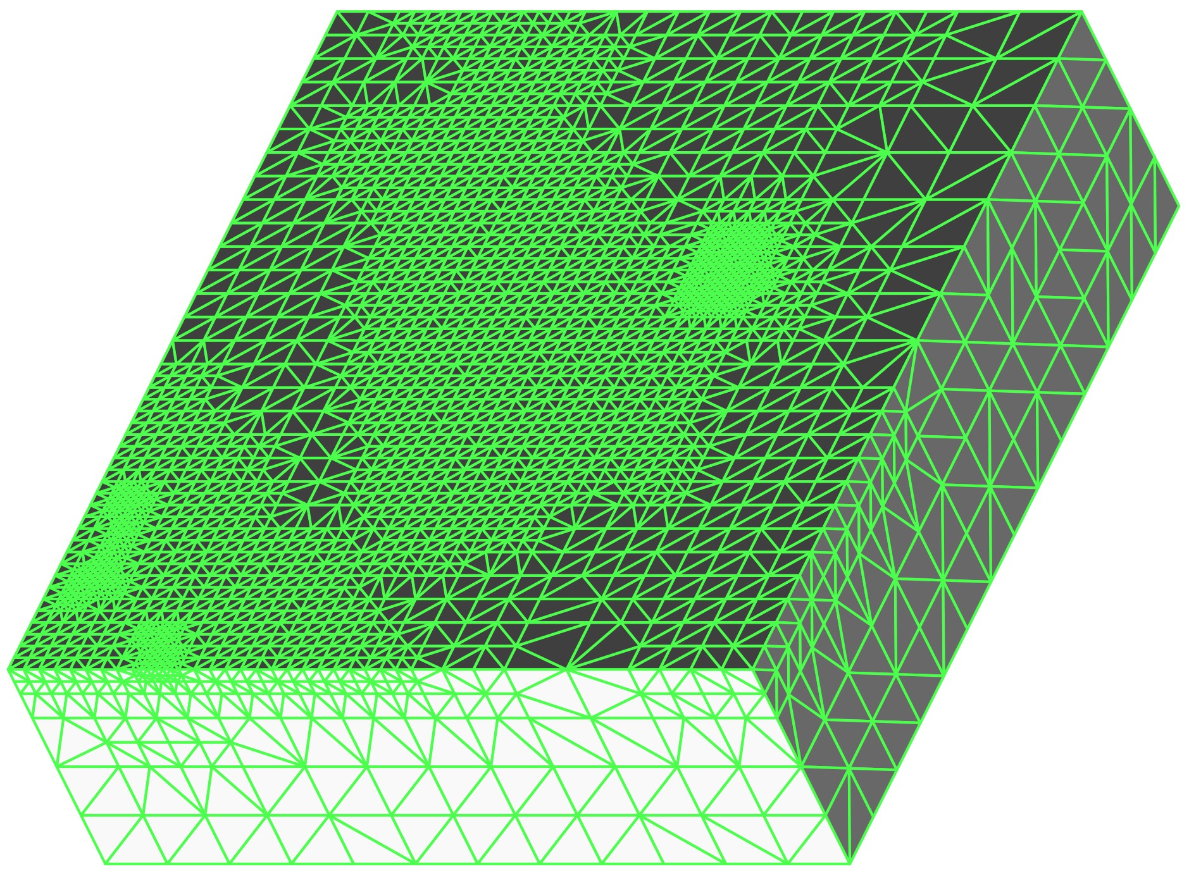
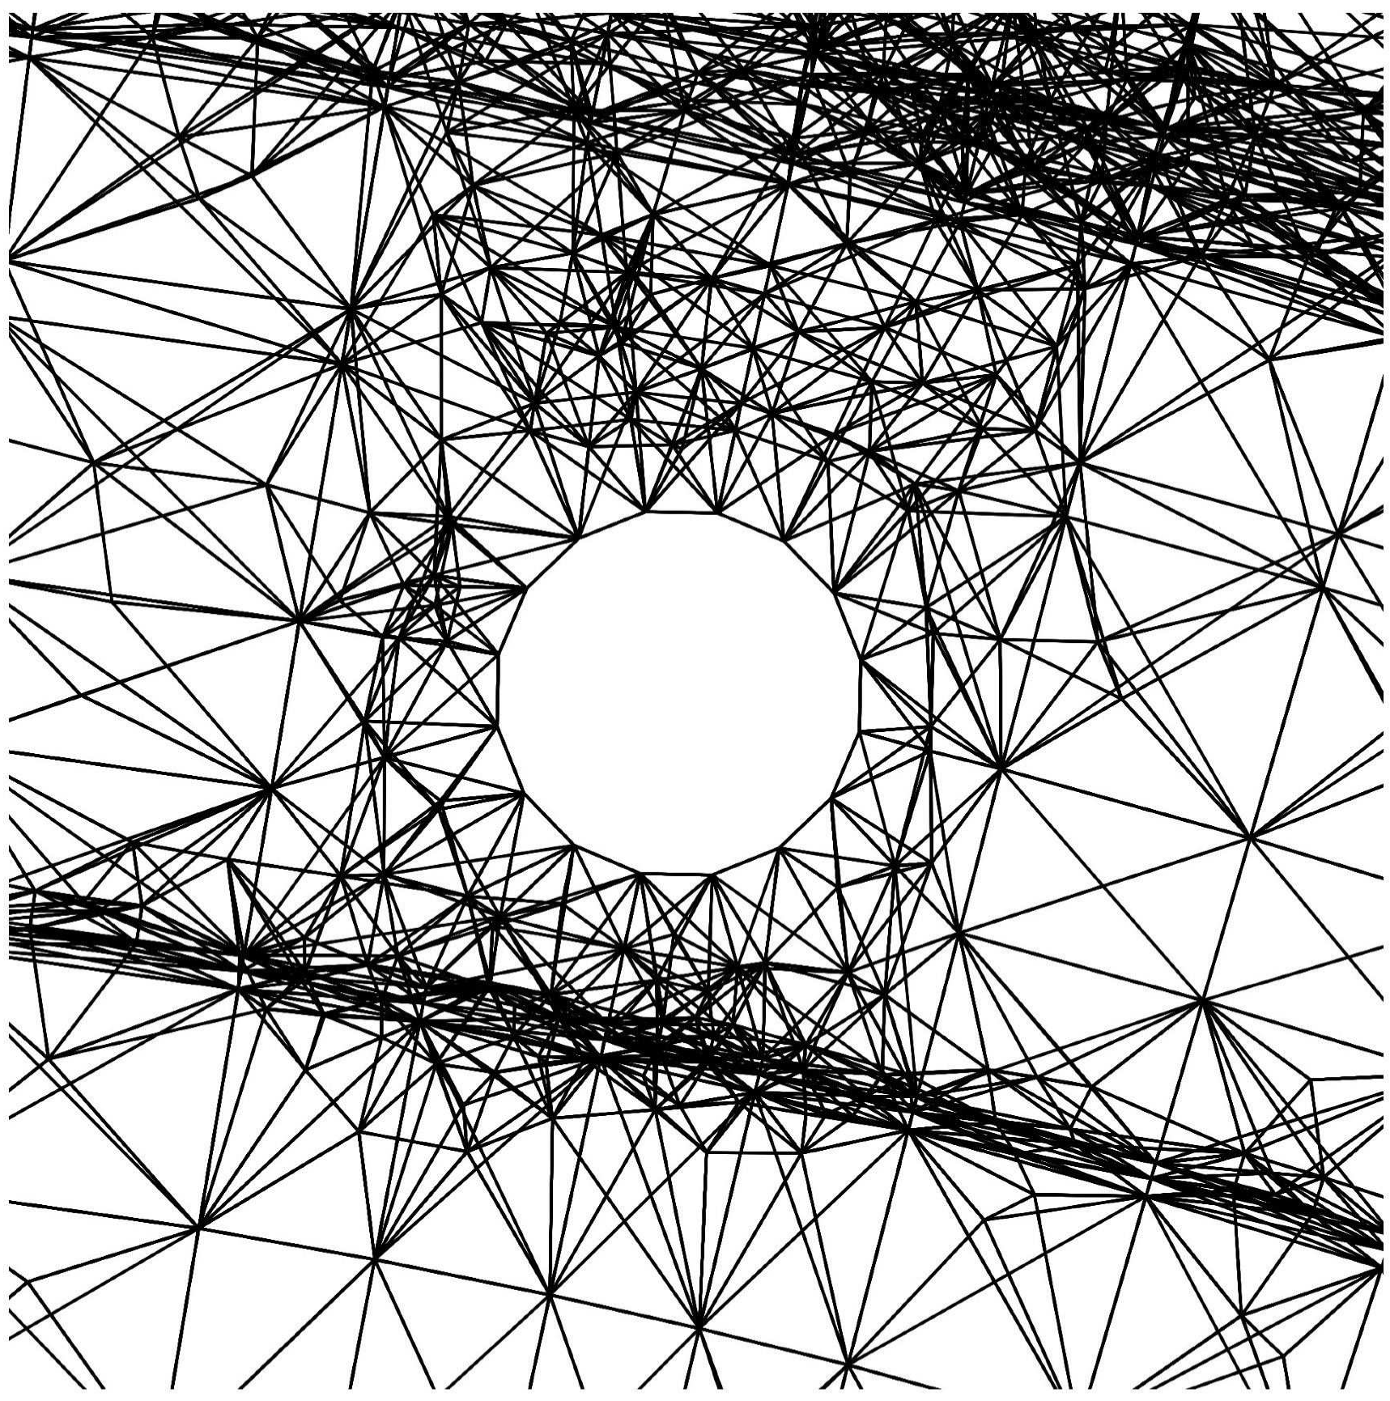
tetrahedral mesh models
Queries
  Point
  Range
  Feature
Node
Element
Example: Visualization
  Show ground velocity at Q
  Draw the temperature of R
Point Query Q
Range Query R
Courtesy Cornell Fracture Group
goal: efficiently process geometric queries

Slide 15
R-Tree indexing
M
F
E
C
Minimum Bounding Rectangle (MBR)
H
Q
B
Q
G
B
D
A
D
F
A
L
N
C
G
K
H
E
K
L
X
Y
R-Tree Index
X
Y
K
M
L
N
K
L
M
N
A
B
F
E
C
D
G
H
A
B
C
D
E
F
G
H
Disk page
  tight mesh connectivity hurts performance

Slide 16
directed local search
H
B
G
D
Q
A
C
F
E
Q
Point queries
  Step 1: Find a “nearby” element efficiently
  Step 2: Follow path of adjacent elements
Range queries are similar

Slide 17
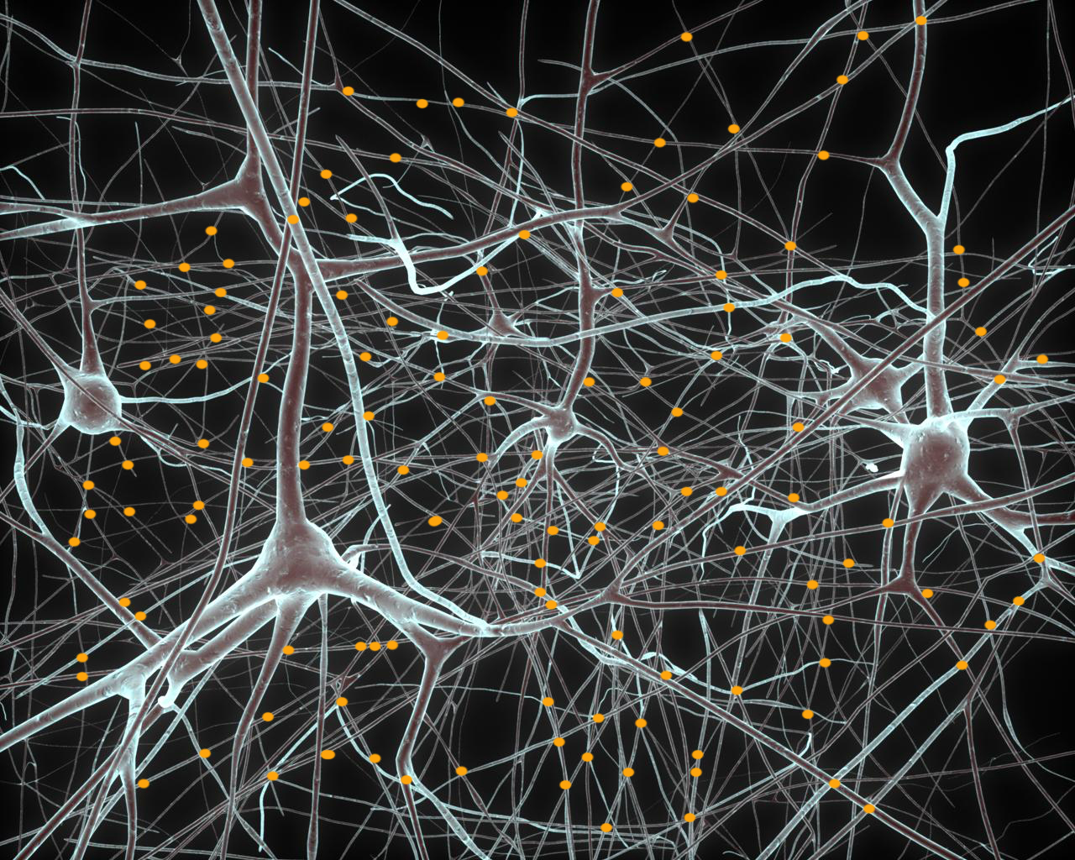
databasing the brain
a spatial data management challenge
J. Kozloski et al., Identifying, tabulating, and analyzing contacts between branched neuron morphologies,
IBM Journal for Research and Development, Issue 52, Number 1/2, 2008

Slide 18
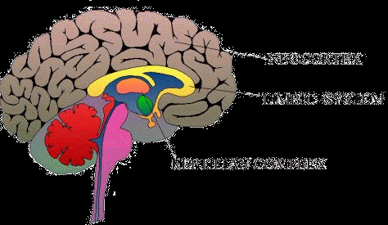
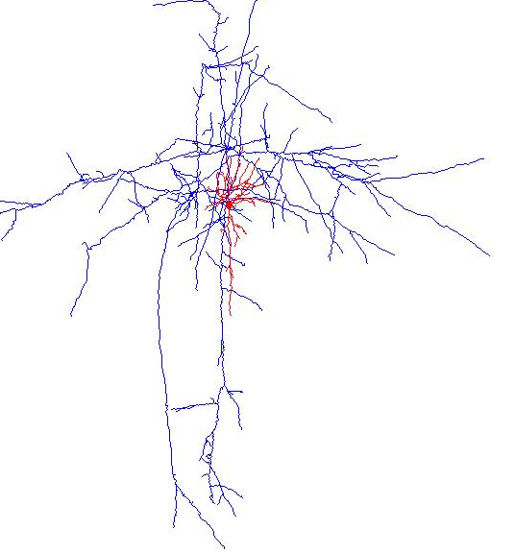
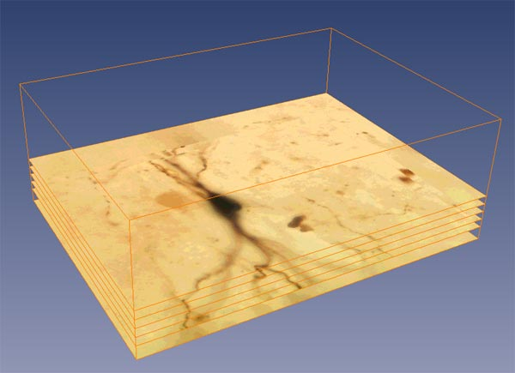
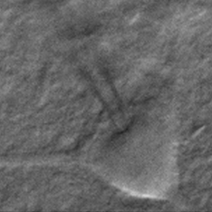
brain simulation
neo cortex
images courtesy of the Blue Brain Project
a neuron
3D reconstruction
dye loading &
raster scanning

Slide 19
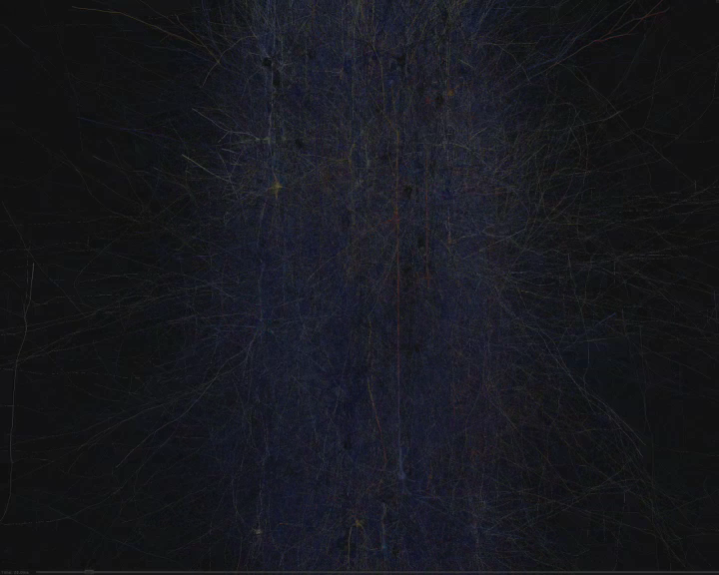
morphologies
single neuron,
modeled with 3D cylinders
human brain: ~86 billion neurons

Slide 20
brain data deluge
before
now
future
# of neurons
1692
1 Layer
100K
10 Columns
100B
Full Brain
segment
representation
4.5M
140MB
450M
13.4GB
4.5x10¹⁴
14PB
mesh
representation
173M
5.8GB
17.3B
580GB
1.7x10¹⁶
0.5EB
molecular representation more fine grained
simulation trace = infinite data

Slide 21
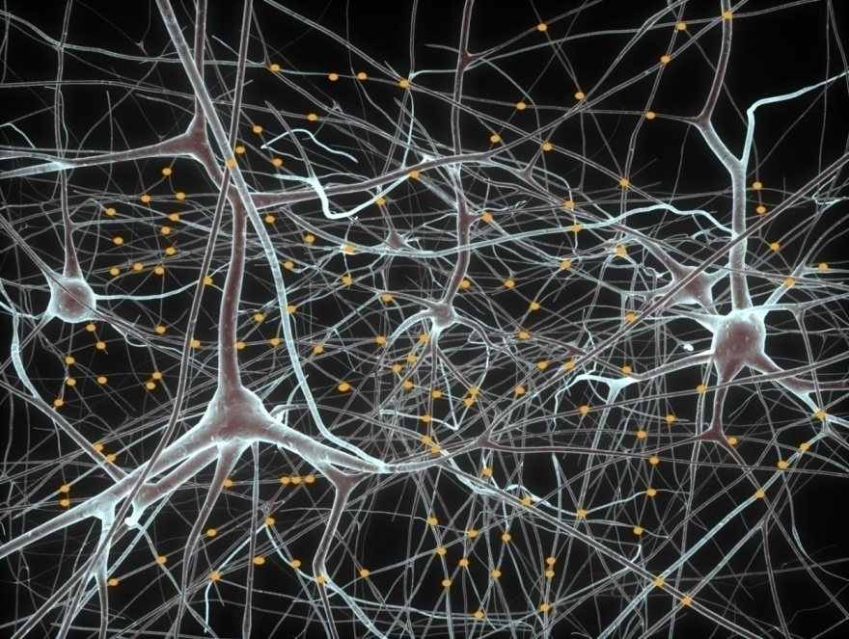
spatial range
morphometric analysis
visualization
model construction
Goal: execute efficiently 3D spatial range queries.
even if data no longer fits into main memory
even if density of dataset increases

Slide 22
traditional spatial indexing
R-Tree
R-Tree on brain data
c
c
c
c
c
c
No overlap
c
c
c
c
c
c
c
c
c
c
# reads increases with density!
too much structural overlap
c

Slide 23
FLAT: insensitive to density
Indexing
  group spatially close objects on disk pages
  add links between neighboring groups
  use traditional R-Tree to index disk pages
Querying
  seed phase: find random element inside range in R-Tree (not affected by overlap)
  crawl phase: use seed element and recursively traverse all neighbors
R-Tree
c
c
c
c
c
c
c
c
c
c
c
c
c
c
Grouping
c
c
c
FLAT indexing
from 10K to 1 million neurons!

Slide 24
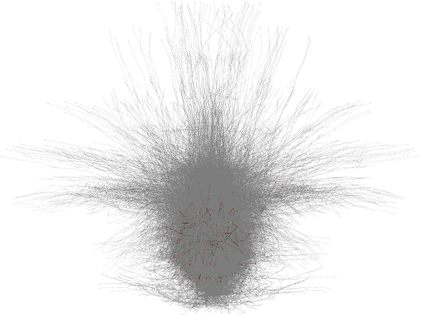
SCOUT: moving range queries
Neural tissue density analysis:
  User issues stream of queries
I/O too costly
even with spatial index
Predict next query
smart&efficient prefetching
Stream of spatial
queries
Neuron
branch
Neuron Tissue Sample (1692 neurons)
query history, density, or content

Slide 25
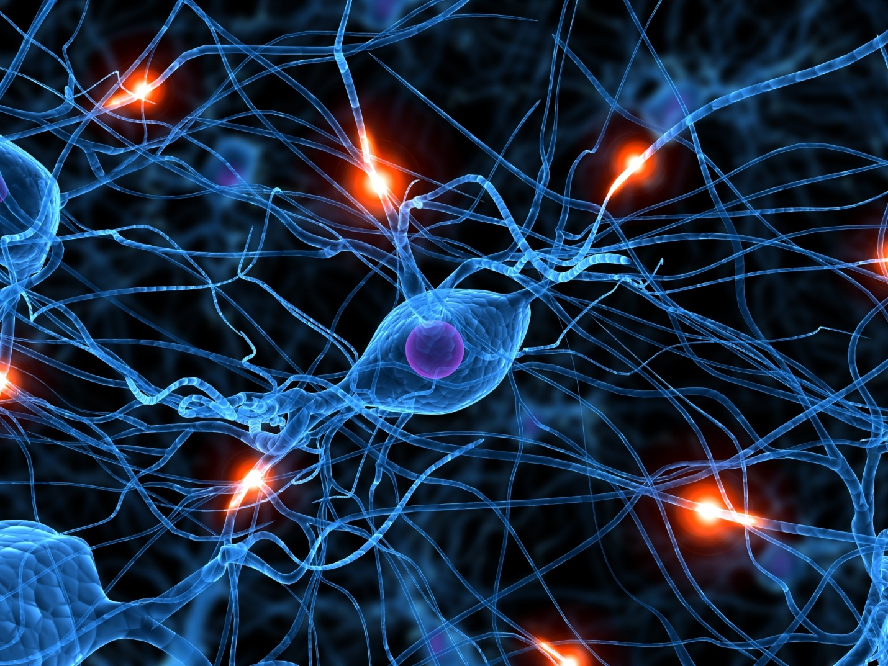
touch detection
Model Synapses
electrical connections between axons and dendrites
Data Challenge
100K neurons => 5B synapses
30GB addl space to store synapse data
Human Brain => 100B neurons ~PB space
Need efficient spatial proximity queries and precise distance calculation.
a major bottleneck in brain simulation

Slide 26
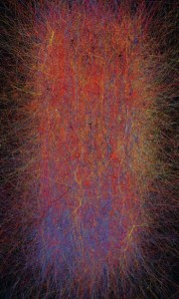
simulation trace analysis
Need accurate data statistics to
Discover and explore neuro-circuit behavior
Compare to behavior of biological tissue
Understand plasticity
Typical trace file ~0.8TB
  for 100K neurons
  for only 1 second of simulation
In-memory efficient access method limit use of complex query analysis
Storage capacity limits longer simulation time
time
need aggressive spatial compression

Slide 27
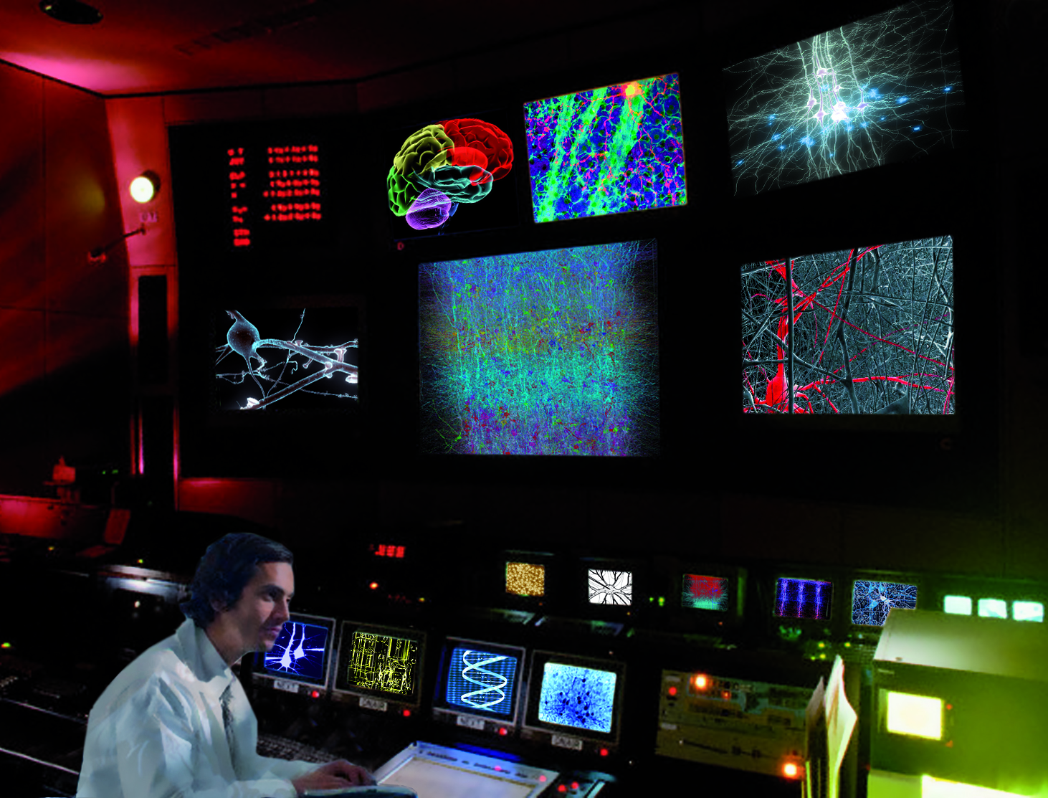
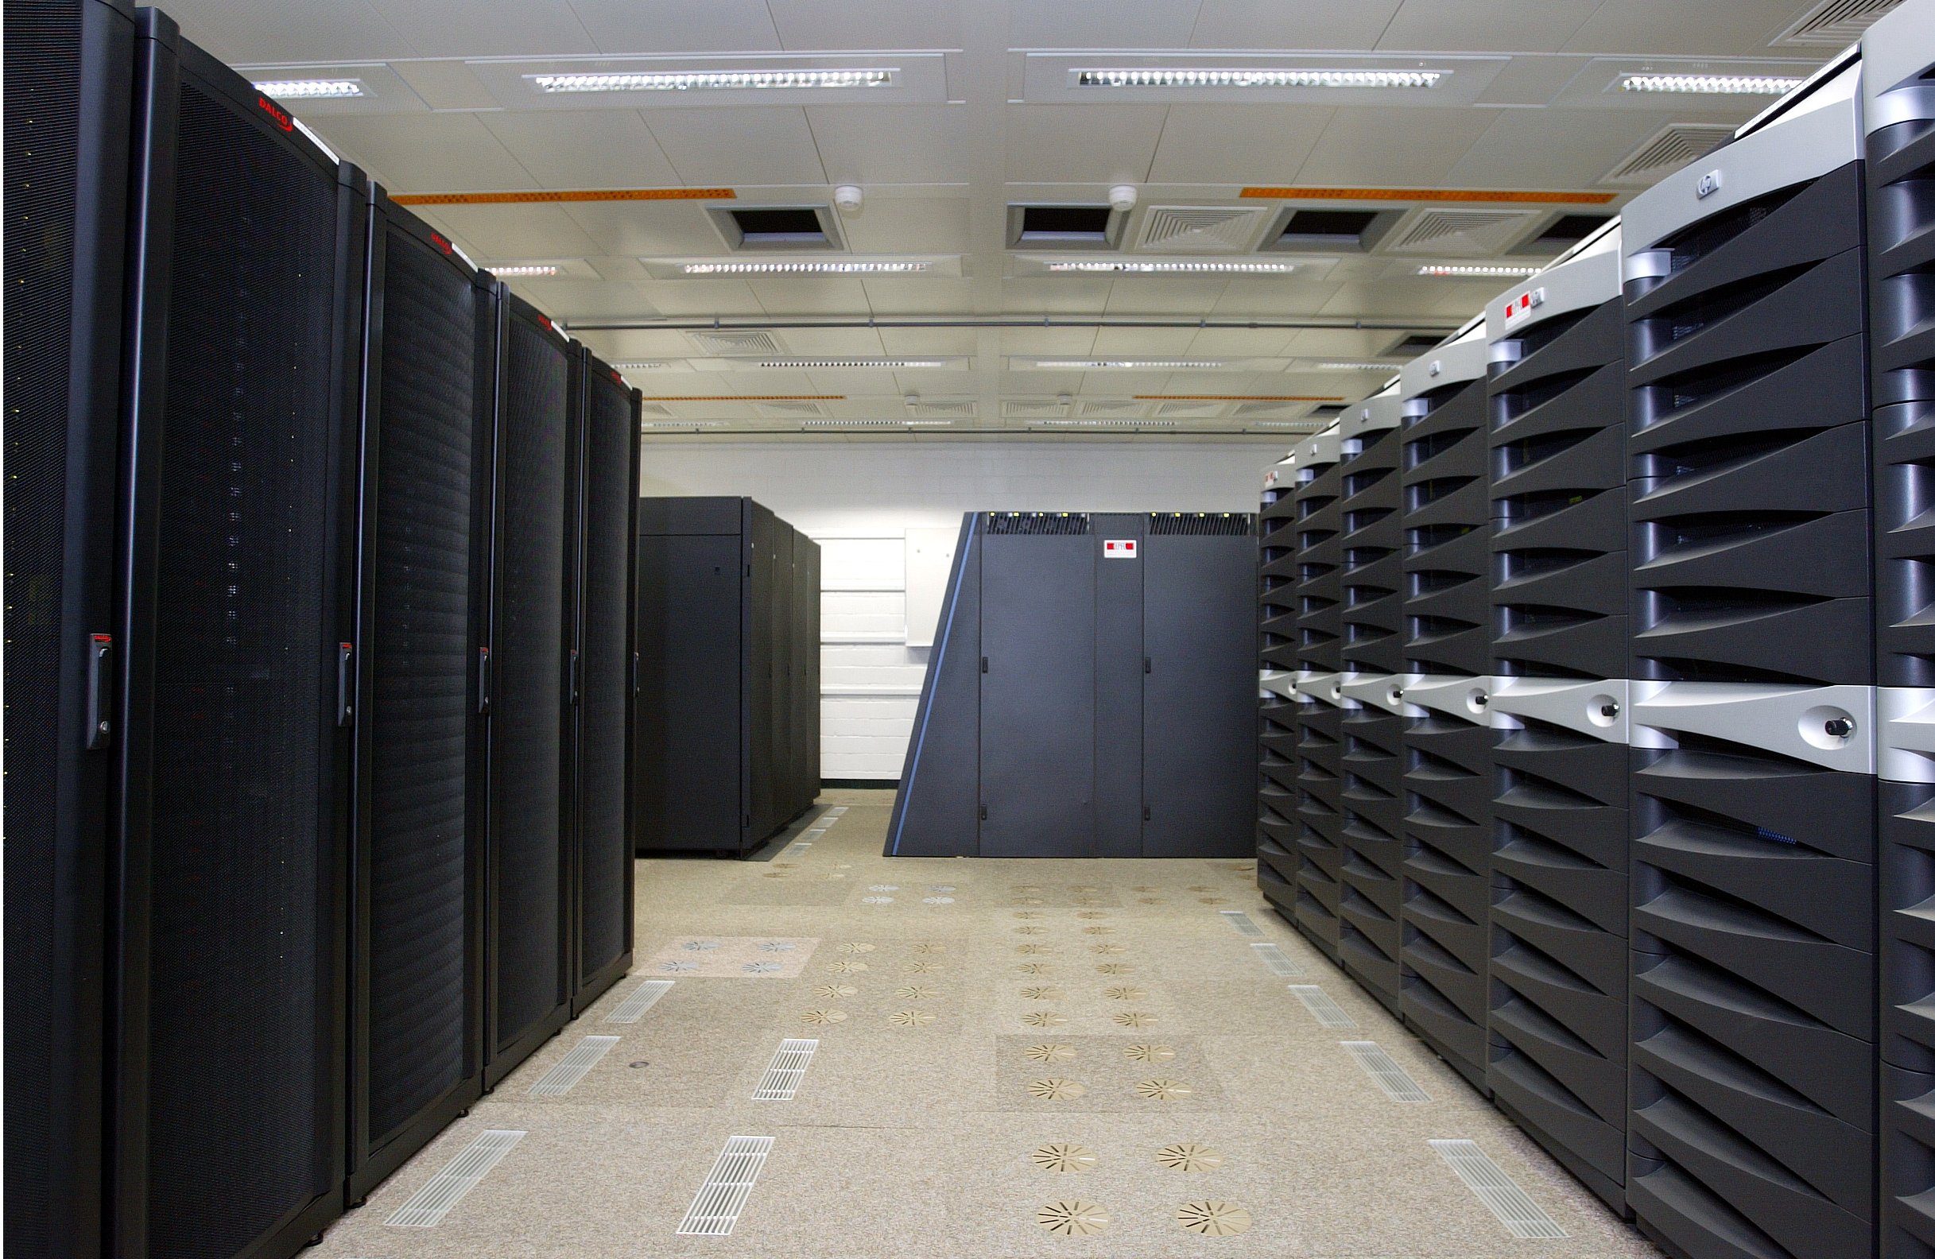
vision: the human brain project, 2021
data
knowledge
patterns
rules
unifying models
data from the Blue Brain Project, EPFL
from molecules to cognition:
a (big) data integration problem

Slide 28
Broader Impact

Slide 29
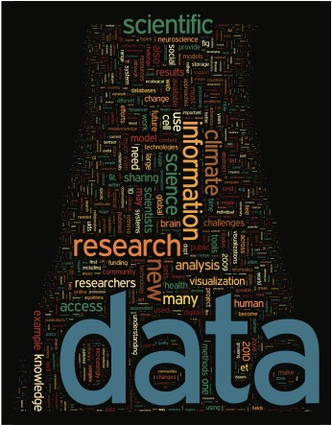
data-driven science
Past:
theory
simulation
experiments
The “fourth paradigm”
scientific breakthrough through computing on massive data

Slide 30
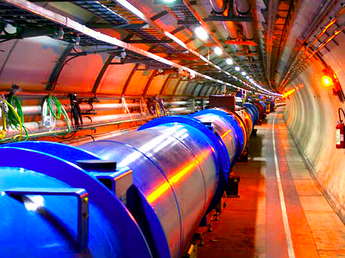
the CERN large hadron collider, now
27km
100M sensors/detection
40M detections/sec
15 PB/year
© 2006 CERN

Slide 31
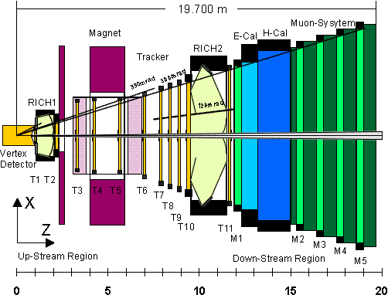
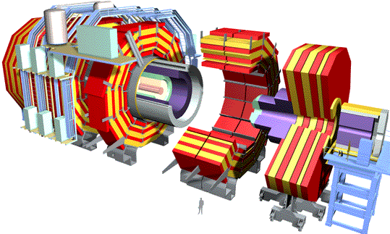
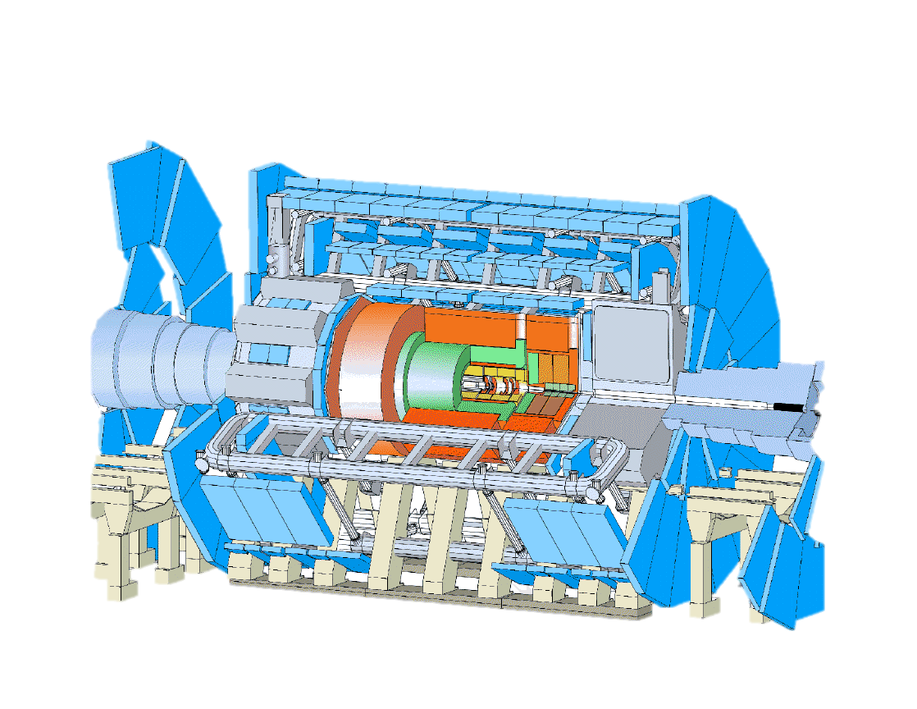
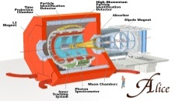
ATLAS experiment (simplified)
LHC Experiments
LHCb
Events from detector
Event Summary Data
CMS
ATLAS
Event filter
ESD
Analysis Object Data
Event simulation
RAW
Event reprocessing
AOD
Search for
Physics Attributes
Find
Dataset
Locate
Dataset
Access Data Files
Metadata
Dataset A
DDM | DQ2
/castor/atlas/dataset.A/file1.v1
/castor/atlas/dataset.A/file2.v1
…
/castor/atlas/dataset.A/file1.v2
…
/castor/atlas/dataset.B/file1.v1
/castor/atlas/dataset.B/file2.v1
...
Version 1
CERN
File 1
File 2
…
……..
File n
Version 2
BNL (USA)
CNAF (IT)
…
RAL (UK)
File 1
Database
File 2
……..
File n
……..

Slide 32
ATLAS-Amsterdam tier-1 re-processing data flow
Tape
Tape
Tape
RAL
FZK
institutions
PIC
RAW
IN2P3
software
AODm2
CNAF
1.6 GB/file
0.026 Hz
2246 f/day
41.6 MB/s
3.4 TB/day
500 MB/file
0.0052 Hz
450 f/day
2.6 MB/s
0.23 TB/day
100%
NDGF
collaborations
AODm2
disk
buffer
100%
ESD2
AODm2
100%
500 MB/file
0.0052 Hz
450 f/day
2.6 MB/s
0.23 TB/day
500 MB/file
0.026 Hz
2246 f/day
13 MB/s
1.1 TB/day
500 MB/file
0.0052 Hz
450 f/day
2.6 MB/s
0.23 TB/day
quantity
ESD2
BNL
complexity
legislation
500 MB/file
0.026 Hz
2246 f/day
13 MB/s
1.1 TB/day
60%
ESD2
AODm2
100%
people
500 MB/file
0.0156 Hz
1350 f/day
7.8 MB/s
0.66 TB/day
500 MB/file
0.0052 Hz
450 f/day
2.6 MB/s
0.23 TB/day
CPU
farm
data
Triumf
funding
40%
ESD2
AODm2
100%
500 MB/file
0.0104 Hz
900 f/day
5.2 MB/s
0.44 TB/day
500 MB/file
0.0052 Hz
450 f/day
2.6 MB/s
0.23 TB/day
disk
storage
Taipei
not your everyday transaction
Archive copy

Slide 33
fast query execution?
DB: extract, transform, load, query
time
any alternative approach?
loading
“overhead”
preparation
“overhead”
… lack of trust in database vendors
… databases “forever owning” the data

Slide 34
NoDB: query, query, query, query
Idea: Queries run in-situ, i.e., over raw data files
Large collections of files
Multiple data formats
Integration with existing tools
Changing areas of interest
New technology: fast queries on raw data

Slide 35
lessons learnt
Be patient
  Aim at solving the scientist’s problems, not ours
  Go back to the lab and apply findings
Many solutions necessary, one* does not fit all
  *query language, data model, data type, index
Open our minds to build many bridges to sciences

Slide 36
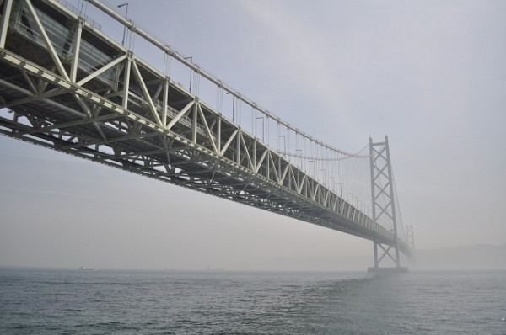
key to turn data into information
collaboration
…an endless source of inspiration

Slide 37
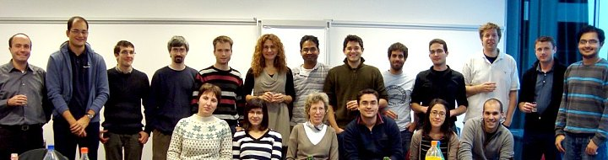
Thank you!
Martha Anderson, Yannis Ioannidis, Miron Livny
Jim Gray, Alex Szalay, Randal Burns, Tanu Malik
Andy Connolly, Bob Nichol, Jeff Gardner
Gerd Heber, Dave O’Hallaron, Julio Lopez
Henry Markram, Felix Schuermann
…and to everyone who collects data

