Slide 1



Distributed Data Management
Serge Abiteboul
INRIA Saclay, Collège de France, ENS Cachan

Slide 2
Distributed computing
A distributed system is an application that coordinates the actions of several computers to achieve a specific task.
Distributed computing is a lot about data
  System state
  Session state including security information
  Protocol state
  Communication: exchanging data
  User profile
  ... and of course, the actual “application data”
Distributed computing is about querying, updating, communicating data ⤳ distributed data management

Slide 3
Parallelism and distribution
Sequential access: 166 minutes (more than 2 hours and a half) to read a 1 TB disk
Parallel access: With 100 disks working in parallel, less than 2mn
Distributed access: With 100 computers, each disposing of its own local disk: each CPU processes its own dataset
This is scalable
100MB/s
1TB
100MB/s
1TB
1TB
1TB
1TB
1TB
network
1TB
1TB
1TB
1TB

Slide 4
Organization
Data management architecture
Parallel architecture
Zoom on two technologies
Cluster (grappe): MapReduce
P2P: storage and indexing
Limitations of distribution
Conclusion

Slide 5
Data management architecture

Slide 6
Deployment architecture
Centralized
Multi-user mainframe & terminals
Client-Server
Multi-user server & terminals workstation
Client: application & Graphical interface
Server: database system
Application
Database system
Application
API (e.g., JDBC)
Database server

Slide 7
Deployment architecture – 3 tier
Client is a browser that
  Displays content, e.g. in HTML
  Communicates via HTTP
Central tier
  Generates the content for the client
  Runs the application logic
  Communicates with the database
Data server tier
  Serves data just like in the client/server case
Browser
HTTP
Application
API (e.g., JDBC)
TCP/IP
Database server

Slide 8
Another dimension: Server architecture
Example 1
  Server: single machine
Example 2
  Server: parallel machine
  Deployment: client/server
Application
Application
Database server
DB server
DB server
DB server
5/15/12

Slide 9
Server architecture: Query vs. page/object
Query server
Data server
Application
Application
Application
Application
Page cache
JDBC / ODBC
High-level queries
Answers
Requests
Pages
or objects
Relational server
Page or object
server

Slide 10
Parallel architecture

Slide 11
Parallel architecture
The architecture of a server is typically
multi-CPU, multi-memory, multi-disk
Based on very fast network
Architectures
Shared memory
Shared disk
Shared nothing
Hybrid
P
P
P
P
P
P
P
P
P
P
P
P
P
P
P
P
M
M
M
M
M
M
M
M
M
M
M

Slide 12
Comparison
Shared memory
  The bus becomes the bottleneck beyond 32-64 processors
  Used in practice in machine of 4 to 8 processors
Shared disk
  Inter-CPU communication slower
  Good for fault-tolerance
  Bottleneck pushed to hundreds of processors
No sharing – only for very parallelizable applications
  Higher communication cost
  Scaling to thousands of processors
  Adapted for analysis of large data sets

Slide 13
Main memory database
  Beyond 100 cores
  Beyond 10 Tb memory
Blade server
serveur lame
8 - 16
Blade
RAM
0,5 – 1 TB
4
  Complex programming to leverage parallelism
  Issue: computing power and memory throughput augment – latency augments much less
CPU
L2 cache
1 – 4 Mb
4 - 8
Core
L1 cache
16 – 32 Kb
blades share nothing

Slide 14
Massive parallelism and partitioning
Line store
Column store
Horizontal
Partitioning
Vertical
Partitioning

Slide 15
Line vs. column store
Lines
Columns
Read/write a full tuple: fast
Read/write an attribute for the entire relation: slow
Limited compression
Slow aggregation
Adapted to transactional applications
Read/write a full tuple: slow
Read/write an attribute for the entire relation: fast
Excellent compression
Fast aggregation
Adapted to decisional applications

Slide 16
Massive parallelism & column store
Parallelism
Column store
SGBD-R : Teradata
Neteeza(IBM)
DATAllegro (Microsoft)
Open source : Hadoop
(in a few minutes…)
Sybase IQ
Kickfire (Teradata)
:Open source MonetDB
Parallelism & column store
Exasol
Vertica
Greenplum (EMC)
Opensource: Hadoop HBase

Slide 17
Cluster: MapReduce
To process (e.g. to analyze) large quantities of data
Use parallelism
Push data to machines

Slide 18
MapReduce
MapReduce : a computing model based on heavy distribution that scales to huge volumes of data
2004 : Google publication
2006: open source implementation, Hadoop
Principles
Data distributed on a large number of shared nothing machines
Parallel execution; processing pushed to the data

Slide 19
MapReduce
Three operations on key-value pairs
Map user-defined (transforme)
Shuffle fixed behavior (mélange)
Reduce user-defined (réduire)

Slide 20
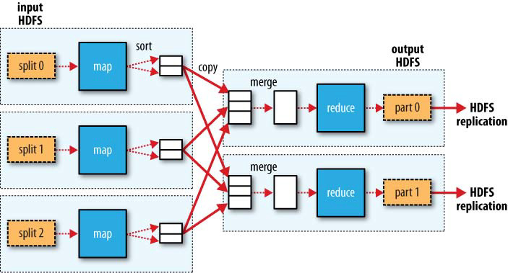
Data flow MapReduce
User defined
User defined
MAP
SHUFFLE
REDUCE

Slide 21
MapReduce example
Count the number of occurrences of each word in a large collection of documents

Slide 22
Map
Jaguar 1
Atari 1
Felidae 1
Jaguar 1…
u1 jaguar world mammal felidae family.
u2 jaguar atari keen use 68K family device.
u3 mac os jaguar available price us 199 apple new family pack
u4 such ruling family incorporate jaguar their name
Jaguar 1
Available 1
Apple 1
Jaguar 2…

Slide 23
Shuffle
Jaguar 1
Atari 1
Felidae 1
Jaguar 1…
…
Jaguar 1
Available 1
Apple 1
Jaguar 2
…
Jaguar 1,1,1,2
Mammal 1
Family 1,1,1
Available 1
…

Slide 24
Reduce
Jaguar 1,1,1,2
Mammal 1
Family 1,1,1
Available 1
…
Jaguar 5
Mammal 1
Family 3
Available 1
…

Slide 25
MapReduce functionalities
Map: (K, V) → list (K’, V’) ; typically:
  Filter, select a (new) key, project, transform
  Split results in M files for M reducers
Shuffle: list (K’, V’) → list (K’, list (V’))
  Regroup the pairs with the same keys
Reduce: (K’, list (V’)) → list (K’’, V’’) ; typically:
  Aggregation(COUNT, SUM, MAX)
  Combination, filtering (example join)
Optional optimization : combine: list(V’) → V’
  Run on a mapper to combine pairs with the same key into a single pair

Slide 26
Hadoop
Open source, Apache implementation in Java
  Main contribution from Yahoo
Main components
  Hadoop file system (HDFS)
  MapReduce (MR)
  Hive: simple data warehouse based on HDFS and MR
  Hbase: key-value column store on HDFS
  Zookeeper: coordination service for distributed applications
  Pig: dataflow language on HDFS and MR ☞
Java and C++ API
  Streaming API for other language
Very active community

Slide 27
Pig Latin
For some author, count how many editors this author has
N1NF model
Example
Compilation in MapReduce
Books = LOAD ’book.txt’ AS (title: chararray, author: chararray,…);
Abiteboul = FILTER Books BY author == ’Serge Abiteboul’;
Edits = LOAD ’editors.txt’ AS (title: chararray, editor: chararray);
Joins = JOIN Abiteboul BY title, Edits BY title;
Groups = GROUP Joins BY Abiteboul::author;
Number = FOREACH groups GENERATE group, COUNT(Joins.editor);
DUMP Number
LOAD
FILTER
LOAD
JOIN
GROUP
FOREACH
DUMP
MAP
REDUCE
MAP
REDUCE

Slide 28
What’s going on with Hadoop
Limitations
  Simplistic data model & no ACID transaction
  Limited to batch operation
  Limited to extremely parallelisable applications
Good recovery to failure
Scales to huge quantities of data
  For smaller data, it is simpler to use large flash memory or main memory database
  Main usage today (sources: TDWI, Gartner)
  Marketing and customer management
  Business insight discovery

Slide 29
Where does this technology fit
Data warehouse
X
X
X X X
ETL
Storage
Business
Intelligence

Slide 30
P2P: storage and indexing
To index large quantities of data
Use existing resources
Use parallelism
Use replication

Slide 31
Peer-to-peer architecture
P2P: Each machine is both a server and a client
Use the resources of the network
  Machines with free cycles, available memory/disk)
Communication: Skype
Processing: seti@home, foldit
Storage: emule

Slide 32

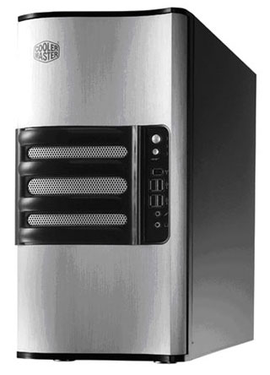
Power of parallelism
Performance, availability, etc.
Server saturates
P2P scales
Parallel loads

Slide 33
Managing a large collection
LAN
Col.
Col. portion
Col. portion
Col. portion
Col. portion
P2P approach
Internet
Col. portion
Col. portion
33
Col. portion
Col. portion
Col. portion
Col. portion

Slide 34
Difficulties
Peers are autonomous, less reliable
Network connection is much slower (WAN vs. LAN)
Peers are heterogeneous
  Different processor & network speeds, available memories
Peers come and go
  Possibly high churn out (taux de désabonnement)
Possibly much larger number
Possible to have peers “nearby on the network”

Slide 35
And the index?
Centralized index: a central server keeps a general index
  Napster
Pure P2P: communications are by flooding
  Each request is sent to all neighbors (modulo time-to-life)
  Gnutella 0.4, Freenet
Structured P2P: no central authority and indexing using an "overlay“ network (réseau surimposé)
  Chord, Pastry, Kademlia
  Distributed HASH table: index search in O (log(n))

Slide 36
Implementation: Chord Ring
k
pid
H(k)
Hashing is modulo 2^{n}
H distributes the peers around the (0.. 2^{n}) ring
  O < H(pid) < 2^{n}
  We assume no two peers have the same H(pId)
H distributes the keys
around the ring
H(pid)
In charge of all keys from H(M_{i}) to H(M_{i+1})
2^{n}
O
…
1

Slide 37
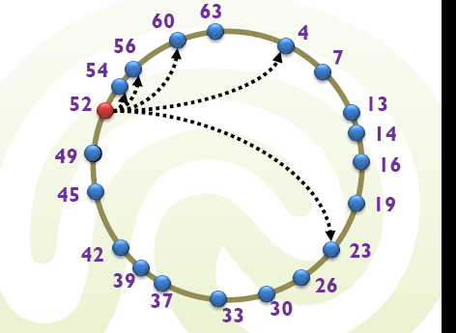
Perform a search in log(n)
Each node has a routing table with : « fingers »
Key k with
H(k) = 13
4<13<23
Forward the
query to the
peer in charge
of 4…
?H(k)

Slide 38
Search in log(n)
Ask any peer for key k
This peers knows log(n) peers and the smallest key of each
Ask the peer with key immediately less than H(k)
In the worst case, divide by 2 the search space
After log(n) in the worst case, find the peer in charge of k
Same process to add an entry for k
Or to find the values for key k

Slide 39
Joining the DHT
M joins
3) Receives all the
entries between
H(M) and H(M_{i+1})
2) Contacts peer M_{i}
In charge of
H(M)
1) Computes
H(M)
In charge of all keys from H(M_{i}) to H(M_{i+1})
In charge of all keys from H(M_{i}) to H(M)
In charge of all keys from H(M) to H(M_{i+1})
2^{n}
O
…
1

Slide 40
Leaving the DHT
M leaves
Sends to previous
peer on the ring
all its entries
(between
H(M) and H(M_{i+1}))
In charge of all keys from H(M_{i}) to H(M_{i+1})
In charge of all keys from H(M_{i}) to H(M)
In charge of all keys from H(M) to H(M_{i+1})
2^{n}
O
…
1

Slide 41
Issues
When peers come and go, maintenance of finger tables is tricky
Peer may leave without notice: only solution is replication
  Use several hash function H1, H2, H3 and maintain each piece of information on 3 machines

Slide 42
Advantages & disadvantages
Advantages
  Scaling
  Cost effective: take advantage of existing resources
  Performance, availability, reliability (potentially because of redundancy but rarely the case in practice)
Disadvantages
  Servers may be selfish, unreliable ⤳ hard to guarantee service quality
  Communication overhead
  Servers come and go ⤳ need replication
  replication overhead
  Slower response
  Updates are expensive

Slide 43
Limitations of distribution: CAP theorem

Slide 44
Main idea
Use heavy distribution
Use heavy replication (at least for popular data)
Is this the magical solution to any management of huge data?
Yes for very parallelizable problems and static data collections
If there are many updates:
Overhead: for each update, we have to realize as many updates as there are replicas
Problem: the replicas start diverging

Slide 45
Properties of distributed data management systems
Scalability refers to the ability of a system to continuously evolve in order to support a growing amount of tasks
Efficiency
  response time (or latency): the delay to obtain the first item, and
  throughput (or bandwidth): the number of items delivered in a given period unit (e.g., a second)

Slide 46
CAP properties
Consistency = all replicas of a fragment are always equal
  Not to be confused with ACID consistency
  Similar to ACID atomicity: an update atomically updates all replicas
  At a given time, all nodes see the same data
Availability
  The data service is always available and fully operational
  Even in presence of node failures
  Involves several aspects:
  Failure recovery
  Redundancy: Data replication on several nodes

Slide 47
CAP properties
Partition Tolerance
  The system must respond correctly even in presence of node failures
  Only accepted exception: total network crash
  However, often multiple partitions may form; the system must
    prevent this case of ever happening
    Or tolerate forming and merging of partitions without producing failures

Slide 48
Distribution and replication: limitations
CAP theorem: Any highly-scalable distributed storage system using replication can only achieve a maximum of two properties out of consistency, availability and partition tolerance
Intuitive; main issue is to formalize and prove the theorem
  Conjecture by Eric Brewer
  Proved by Seth Gilbert, Nancy Lynch
In most cases, consistency is sacrificed
  Many application can live with minor inconsistencies
  Leads to using weaker forms of consistency than ACID

Slide 49
Conclusion

Slide 50
Trends
The cloud
Massive parallelism
Main memory DBMS
Open source software

Slide 51
Trends (continued)
Big data (OLAP)
  Publication of larger and larger volumes of interconnected data
  Data analysis to increase its value
    Cleansing, duplicate elimination, data mining, etc.
  For massively parallel data, a simple structure is preferable for performance
    Key / value > relational or OLAP
    But a rich structure is essential for complex queries
Massive transactional systems (OLTP)
  Parallelism is expensive
  Approaches such as MapReduce are not suitable

Slide 52
3 principles?
New massively parallel systems ignore the 3 principles
  Abstraction, universality & independence
Challenge: Build the next generation of data management systems that would meet the requirements of extreme applications without sacrificing any of the three main database principles

Slide 53

Reference
Again the Webdam book: webdam.inria.fr/Jorge
Partly based on some joint presentation with Fernando Velez at Data Tuesday, in Microsoft Paris
Also:
Principles of distributed database systems, Tamer Özsu, Patrick Valduriez, Prentice Hall

Slide 54

Merci !
Notes:
1:15 + 15mn questions
Développer
Webcontent – expliquer plateforme ANR – archi et ½ transparents pour chaque appli
Gestion de requetes en P2P
Business artifacts
Conclusion – de maquette à proto à recherche exploratoire
prévisions sur le Web: modeste
Voir transparents cantine
Ralentissement? Sujets durs: linguistique, gestion de connaissances

Slide 55

Gerhard Weikum
Max-Planck-Institut für Informatik
Fellow: ACM, German Academy of Science and Engineering
Previous positions: Prof. Saarland University, ETH Zurich, MCC in Austin, Microsoft Research in Redmond
PC chair of conferences like ACM SIGMOD, Data Engineering, and CIDR
President of the VLDB Endowment
ACM SIGMOD Contributions Award in 2011

