Slide 1
The Relational Model
Serge Abiteboul
Chaire informatique et sciences numériques
3/19/12
3/19/12
1
1

Slide 2
The course
3 classes on data models
The relational model
Beyond relational
Semantic web
2 cool topics
Workflows and active documents
Web search engines
3 classes towards distributed knowledge
Datalog
Distributed data management
Distributed knowledge bases
8 seminars

Slide 3
Organization
The principles
Abstraction
Universality
Independence
Abstraction: the relational model
Universality: main functionalities
Independence: the views revisited
Optimization, complexity and expressiveness
A jewel of databases
Conclusion

Slide 4
The principles

Slide 5
Database Management System
Goal: the management of large amounts of data
Large data: database
Large software to manage them: DBMS
Very complex systems
Years of research and development by large groups of researchers/engineers
Characteristics of the data
Persistence over time (years)
Possibly very large (giga, tera, etc.).
Possibly distributed geographically
Typically shared between many users and programs
Typically stored on heterogeneous storage : hard disk, network

Slide 6
Key role: Mediation between human and machines
The data management system acts as a mediator between intelligent users and objects that store information
First order logic: precise and unambiguous syntax and semantics
Program: Alice does not want to write it; she does not have to
∃ t,d ( Film(t, d, « Bogart ») ∧ Séance(t, s, h) )
Où et à quelle heure puis-je voir un film avec Bogart?
intget(intkey){
inthash=(key%TS);while(table[hash]=NULL&&table[hash]->getKey()=key)
hash=(hash…

Slide 7
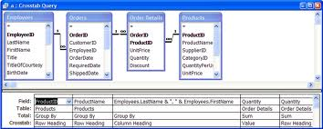
1st principle: abstraction
High level data model
Definition language for describing the data
Manipulation language: queries and updates
Definition language based on simple data structure
Relations
Trees
Graphs
Formal language for queries
Logics
Declarative vs. Procedural
Graphical languages
Complex graphical queries
with MS Access

Slide 8
2nd principle: universality
DBMSs are designed to capture all data in the world for all kinds of applications
Powerful languages
Rich functionalities: see further
To avoid multiplying developments
In reality
Less structured data are often stored in files
Too intense applications require specialized software
More and more the case

Slide 9
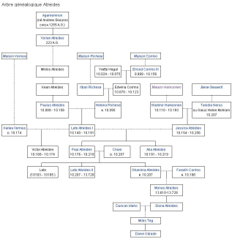
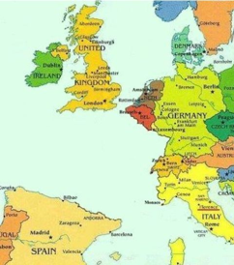
3rd principle: independence
Views
ANSI-SPARC Architecture (75): 3 levels
Separation into three levels
Physical level: physical organization of data on disk, disk management, schemas, indexes, transaction , log
Logic: logical organization of data in a schema, query and update processing
Externally: views, API, programming environments
Independence
Physical: We can change the physical organization without changing the logical level
Logical: We can evolve the logical level without modifying the applications
External: We can change or add views without affecting the logical level
External level
Logical
level
Physical level

Slide 10
1st principle: abstraction
High level data model: The relational model

Slide 11
The relational model
Codd 1970
Data are represented as tables, namely relations
Queries are expressed in relational calculus: « declarative »
Essentially First order logic
In practice, a richer model/language: SQL
Ordering between tuples, nesting, aggregate functions, nulls…
Very successful both scientifically and industrially
Commercial systems such as Oracle, IBM’s DB2
Popular free software like mySQL
DBMS on personal computers such as MS Access

Slide 12
Relations

Slide 13
Queries are expressed in relational calculus
q_{HB} = { s, h | ∃ d, t ( Film(t, d, « Humphrey Bogart ») ∧ Séance(t, s, h ) }
In practice, using a syntax that is easier to understand:
SQL:
select salle, heure
from Film, Séance
where Film.titre = Séance.titre and acteur= «Humphrey Bogart»

Slide 14
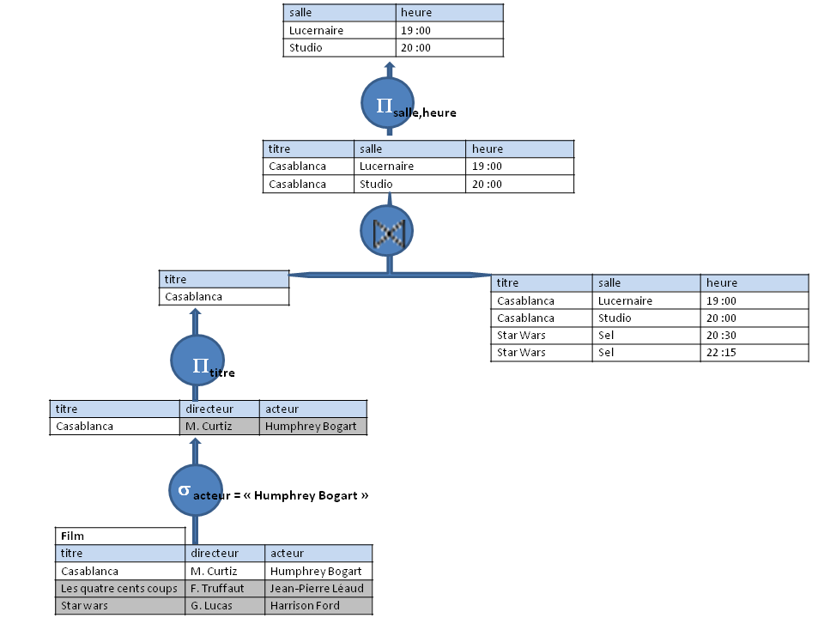
Relational algebra
Queries are translated in algebraic expressions and evaluated efficiently

Slide 15
The main predecessors
Trees
Graphs
IMS, IBM late 60s, 70s
Still very used
A hierarchy of records with keys
Codasyl
A graph of records with keys
Supplier(sno, sname, sadd)
Supplier(sno, sname, sadd)
Part(pno, pname)
Little abstraction
Languages
Navigational
Procedural
Record-at-at-time
Part(pno, pname, qty, price)
Order(ono, qty, price)

Slide 16
The main successors: semistructured data models
Trees
Graphs
XML
Exchange format for the Web
Standard
Query languages: Xpath, Xquery
Developing very fast
Abstraction
Logic foundations
High-level languages
Next two classes
Semantic Web & RDF
Format for representing knowledge
Standard
Query language: SPARQL
Developing very fast

Slide 17
2nd principle: universality
Must support many functionalities

Slide 18
Two main classes of applications with important needs for data management
OLTP: Online Transaction Processing – Transactional
E-commerce, banking, etc..
Simple transactions, known in advance
Very high load in number of transactions per second
OLAP: Online Analytical Processing – Decision making
Business intelligence queries
Often very complex queries involving aggregate functions
Multidimensional queries: e.g., date, country, product

Slide 19
Towards universality: more functionalities
Applications have essential functional requirements such as :
Concurrency and transactions
Reliability, security, access control
Data distribution
Performance and scaling

Slide 20
Towards universality: performance and scaling
Many applications have severe performance requirements
Response time: The time per operation
Throughput: The number of operations per time unit
We need to be able to scale
Volume of data Terabytes of data
Volume of requests Millions of requests per day
For this two main tools
Optimization
Parallelism

Slide 21
Dependencies
Laws about the data
Examples
Séance[titre] ⊆ Film[titre] Inclusion dependency
Only known films are shown
Séance: salle heure → titre Functional dependencies
Only one movie is shown at a time in a theater
Logical formulas
∀ t, s, h (Séance(t, s, h ) ⇒∃ d, a ( Film(t, d, a) ) ) tgds
∀ t, t’, s, h (Séance(t, s, h ) ∧ Séance(t’, s, h ) ⇒ t=t’) egds
Some of the most sophisticated developments in db theory
To protect data | To design schemas
To optimize queries | To explain data

Slide 22
Dependencies and schema design
Use simple dependencies up to complex semantic data models
Help choose a better relational schema
Update anomalies
Null values
Person | Child
John | Toto
John | Zaza
Sue | Lulu
Sue | Mimi
Person | Child | Car
John | Toto | BMW
John | Toto | 2chevaux
John | Zaza | BMW
John | Zaza | 2chevaux
Sue | Lulu
Sue | Mimi
Person | Car
John | 2chevaux
John | BMW

Slide 23
Concurrency and transactions - ACID
Atomicity: the sequence of operations is indivisible; in case of failure, either all operations are completed or all are canceled
Consistency: The consistency property ensures that any transaction the database performs will take it from one consistent state to another. (So, consistency states that only consistent data will be written to the database).
Isolation: When two transactions A and B are executed at the same time, the changes made by A are not visible to B until transaction A is completed and validated (commit).
Durability: Once validated, the state of the database must be permanent, and no technical problem should lead to cancelling of transaction operations

Slide 24
Recovery from failures
The DBMS must survive failures
A variety of techniques
Journal
Back-up copies
Shadow pages
“Hot-standby“: second system running simultaneously
Availability: users should not have to wait beyond what is seen as reasonable for an application

Slide 25
Distributed data
Typically the case
When integrating several data sources
Organizations with many branches
Activities involving several companies
When using distribution to get better performance
Query processing over distributed data
Data localization & global query optimization
Data fragmentation
Typically horizontal partitioning
Distributed transactions
Two-phase commit
Typically too heavy for Web applications

Slide 26
More
Security
Protect content against unauthorized users (humans or programs)
Confidentiality: access control, authentication, authorization
Data monitoring
Data cleaning
Data mining
Data streaming
Spatiotemporal data
Etc.

Slide 27
3rd principle: independence
Views

Slide 28
Views
Definition:
Function: Database → Database
Perhaps the most fundamental concept in databases
0 | 1
0 | 2
0
0 | 1
0 | 2
View States
Database
states
π₁
0 | 1
0 | 2
1 | 1
1 | 2
1 | 1
1 | 2
1

Slide 29
View definition
Classical query
Define view …
Implicit definition and recursion
Datalog
Dependencies (tgds)
Mix explicit/implicit: Active XML
<state n=‘Colorado’>
<resort n=‘Aspen’>
<sc> Unisys.com/snow(“Aspen”) </sc>
<sc> Yahoo.com/GetHotels(“Aspen”)</sc>
</resort> …
</state>
state
n
resort
resort
Colorado
n
f
t
g
n
Aspen
2 meters
1 meter
Lake Tahoe

Slide 30
To materialize or not
Intentional
Update: do nothing
Query: complex
Materialized
Update: propagate
Base → view: costly
view maintenance
View → base: ambiguous
Query: simple
Query vs. Update
The database trade-off

Slide 31
Integration: view over several bases
Intentional: mediator
Queries are complex
Materialized: warehouse
Updates are complex
Definitions
Global-as-view: v = ϕ(db₁, … , db_{n})
Local-as-view: db_{i}= ϕ_{i}(v) for each i
Complex logical constraints between the database and the views

Slide 32
Optimization, complexity and expressivity

Slide 33
The reasons of the success
Calculus: The queries are based on relational calculus, a logical language, simple and understandable by people especially in variants such as SQL.
Algebra: A calculus query can easily be translated into an algebraic expression (Codd Theorem) that can be evaluated efficiently.
Optimization: The algebra is a limited model of computation (it does not allow computing arbitrary functions). That is why it is possible to optimize algebraic expressions evaluation.
Parallelization: Finally, for this language, parallelism allows scaling to very large databases (class AC0).

Slide 34
Rewriting algebraic expressions
Π
Projection
sur salle, heure
Π
Π
Sélection « acteur =
« Humphrey Bogart » »
σ
⨝
⨝
Hashjoin
For each f in film
For each s in séance do … complexity in ∼ n²
If few tuples pass the selection complexity in ∼ n
Using the index complexity ∼ constant
⨝
Π
σ
I
N
D
E
X
Film
Séance
σ
Séance
Film
Séance
Film

Slide 35
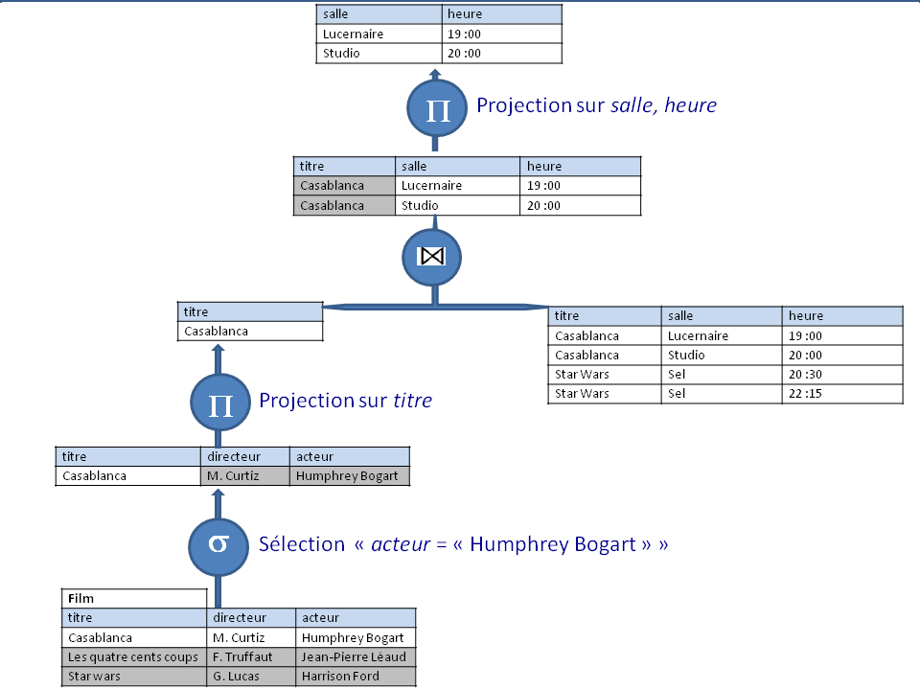
A possible query plan (without index)

Slide 36
Optimization
Using access structures
Hash
B-trees
Using sophisticated algorithms
E.g., merge join
Cost evaluation to select an execution plan
Problem: search space is too large
Technique: Rewrite queries based on heuristics to explore only part of it

Slide 37
Optimization & scaling using parallelism
Not all problems can take advantage of parallelism
Data management can greatly benefit from parallelism
Relational calculus is in AC0
Acyclic join queries are embarrassingly parallelizable
Typically divide the data and work separately on pieces
Filtre f
f
f
f
f

Slide 38
Complexity and expressivity
Moshe will speak about that

Slide 39
A jewel of databases
Containment of conjunctive queries

Slide 40
Containment of conjunctive queries
Q = { x |∃x’,x”,y ( R(xy) ⋀ R(x’y) ⋀ R(x”,1)) }
Q
x | y
x’ | y
x” | 1
I
 | 2
3 | 2
4 | 1
 | 20
30 | 20
30 | 1
5 | 5
V1
1
Q(I)
1
10
10
x
V2

Slide 41
Another query
∃x’,x”,y ( R(xy) ⋀ R(x’y) ⋀ R(x”,1) ⋀ x’ = x” ⋀ R(z,z) )
Q’ = ∃x’,y,z ( R(xy) ⋀ R(x’y) ⋀ R(x’,1) ⋀ R(z,z) )
Q’
x | y
x’ | y
x’ | 1
z | z
I
1 | 2
3 | 2
4 | 1
10 | 20
30 | 20
30 | 1
5 | 5
V1
Q’(I)
10
x
V2

Slide 42
Question
Definition: Q’ ⊆ Q if for all I, Q’(I) ⊆ Q(I)
Q’ ≣ Q if Q’ ⊆ Q and Q ⊆ Q’
Problem: given Q’, Q, test whether Q’ ⊆ Q
Central issue for query optimization

Slide 43
If there is a homomorphism from Q to Q’, Q’ ⊆ Q
I
1 | 2
3 | 2
4 | 1
10 | 20
30 | 20
30 | 1
5 | 5
Q’(I)
10
Q
x | y
x’ | y
x” | 1
Q’
x | y
x’ | y
x’ | 1
z | z
H
V
⊆
Q(I)
10
x
x
HoV

Slide 44
If Q’ ⊆ Q, there is a homomorphism from Q to Q’
Q’
x | y
x’ | y
x’ | 1
z | z
Identity
IQ’
x | y
x’ | y
x’ | 1
z | z
Q’(IQ’)
x
Q’ ⊆ Q
x
Q
x | y
x’ | y
x” | 1
H
Q(IQ’)
x
x
3/19/12
44

Slide 45
Q’ ⊆ Q iff there is a homomorphism from Q to Q’ The problem is NP-complete

Slide 46
Disjunction
Thm: ∪Q’_{i} ⊆ ∪Q_{j} iff for each i, there exists j, Q’_{i} ⊆ Q_{j}
⟸) Suppose for each i, there exists j, Q’_{i} ⊆ Q_{j}
Let I be some instance: consider some I; there exists j, Q’_{i}(I) ⊆ Q_{j}(I)
Q’_{i}(I) ⊆ ∪Q_{j}(I); so, ∪Q’_{i} (I) ⊆∪Q_{j} (I); so,∪Q’_{i} ⊆ ∪Q_{j}
⇒) Suppose ∪Q’_{i} ⊆ ∪Q_{j}
(to simplify assume wlg they are Boolean queries)
Consider some i and the instance IQ’_{i}
∪Q’_{i} (IQ’_{i} ) not empty; so ∪Q_{j}(IQ’_{i} ) not empty;
For some j, Q_{j}(IQ’_{i} ) not empty;
So there is a homomorphism from Q_{j} to Q’_{i}

Slide 47
Beyond
Negation: containment of FO queries is undecidable
co r.e. for finite relations (r.e. for arbitrary relations)
Recursion: containment of datalog is undecidable
Decidable for monadic datalog
Undecidable for monadic datalog over trees or strings (for infinite alphabet)
Tableau homorphism is a particular case of subsumption in resolution theorem proving

Slide 48
Conclusion

Slide 49
Relational databases
Very successful in industry
Lots of results in academia

Slide 50
Blend with other technologies
Logic programming
Production rule systems
Object-oriented languages
Workflows
Clusters of machines
Peer-to-peer architecture

Slide 51
Always question everything
In industry: to challenge the well established guys
In academia: to discover new problems
Revisit the models, languages​​, principles
Main motivations
To facilitate application development
Performance to scale to always more data and queries
For extreme applications that cannot be supported by standard technology
Web search engines with huge volumes of data/queries
World wide banking with huge volumes of transactions
To offer more in terms of reliability, security, etc..

Slide 52
For instance, what can be questioned
Relational model | Beyond
Entries in relations are atomic values | Entries are set of values
 | Missing data, probabilistic data
 | Spatio-temporal data
Data are regular | Semistructured
ACID | Weaker concurrency
Universal | Specialized: noSQL
Data are persistent | Persistent queries on data flows
Data are static | Data & behavior: Object databases Active databases
Constraints are static (FDs, etc.) | Triggers
…

Slide 53
Merci !
Foundations of databases, S. Abiteboul, R. Hull, V. Vianu. Addison-Wesley. 1995. www.webdam.inria.fr/Alice
Database Systems: The Complete Book, J.Widom, J.D. Ullman, H.Garcia-Molina
Databases, M. Benedikt et P. Senellart, E. K. Blum et A. V. Aho, éditeurs, Computer Science. The Hardware, Software and Heart of It. Springer-Verlag, 2012.
3/19/12
3/19/12
53
53

